Slide 1
8086 Microprocessor
Dr.S.Venkatesh | AP | ECE | IIIT-Kottayam

Slide 2
AGENDA
Features of 8086 microprocessor
Architecture of 8086 MP
Addressing modes of 8086 MP
Instruction Set of 8086 MP

Slide 3
Introduction
8086 Microprocessor was developed by Intel in they 1979
8086 has 16 bit ALU, that can perform 16 bit arithmetic and logical operations
Operating speed is significantly improved as compared to 8085
It has 16 bit data bus that transfers 2 bytes of data/machine cycle (as compared to 8085 that did only 1byte/machine)
It has 20 bits of Address bus, that can interface 2^20= 1MB (as compared to 8085 that had only 16 bits of address bus)
It has two internal hardware units: BIU (Bus Interface Unit) and EU (Execution Unit)
Henceforth, it supports pipelining, so that multiple instructions are executed in parallel
It has 4 GPRs (General Purpose Registers) which are AX, BX, CX, and DX

Slide 4
Introduction
They can be used as 8 bit registers as well by splitting support provided by the instruction set, like AH, AL, BH, BL, CH, CL and DH, DL wherein, H refers to higher and L refers to lower
There are two 16 bits index registers (SI and DI). Two 16 bits stack pointers (SP and BP)
8086 supports memory segmentation (CS, DS, ES and SS) CS- Code Segment; DS-Data Segment, ES-Extra Segment and SS-Stack Segment
16 –bits flag register with some additional flags (status flag and control flag)
Two hardware modes: Maximum mode and minimum mode
Maximum mode: We can operate 8086 with multiple processors
Minimum mode: Single 8086 will function

Slide 5
Introduction
It has memory banks. 1 MB divided into two 512 KB lower bank (even) and higher bank (odd)
It has upgraded instruction set and interrupt service
Eg: Multiplication, division, string operation, code conversion are available
Upgraded interrupt service
256 vectored interrupts (unlike 8 vectored interrupts in 8085)

Slide 6
PIPELINING IN 8086

Slide 7
SPEEDING UP THE EXECUTION
Increasing the data bus (8 → 16 bit bus)
Increasing the system clock (so, more cycles of execution in given time)
Upgrading ALU (16 bits processor as compared to 8 bits processor)
Upgrading memory technology (like SSD, including cache memory etc)
Upgrading instruction set (like multiplication, division in 8086 than 8085)
Pipelining (it helps to execute multiple instructions in parallel)

Slide 8
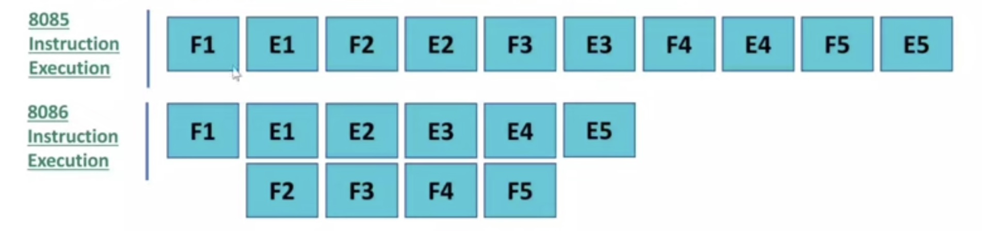
Execution of 8085 and 8086
With and without pipelining
F- Fetching, E-Execution

Slide 9
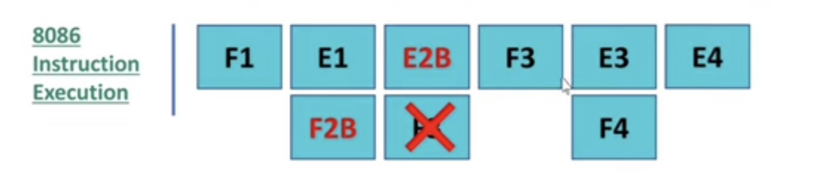
pipelining issues
What if a branch instruction is encountered during execution?
F- Fetching, E-Execution
During branching, the instruction fetched from successive memory location will be discarded
Issue: A delay of 1 clock cycle has occurred to fetching of wrong instruction
Solution could be Branch prediction

Slide 10
Memory banking
How to read 16 bits of data from 8-bit memory location?
Recall 8086 has 16 bits data lines, so it can read 2 bytes of data in a single machine cycle
To read 16 bits of data, it has to fetch data from 2 different memory locations
If both the memory locations are on the chip then, reading of 2 bytes is not possible
This is alleviated by memory banking, wherein odd locations are stored in one chip of 512 KB and even locations are stored in one chip of 512 KB summing up to 1 MB. These chips are called memory banking
So, it is understood that, to read 2 bytes, these two consecutive bytes have to be located in different memory banks, i.e. even memory bank and odd memory bank
Generally for even memory bank provides lower byte and odd memory bank provides higher byte. So we should write program from even memory locations
Remember, the microprocessors from Intel are Little Endian

Slide 11
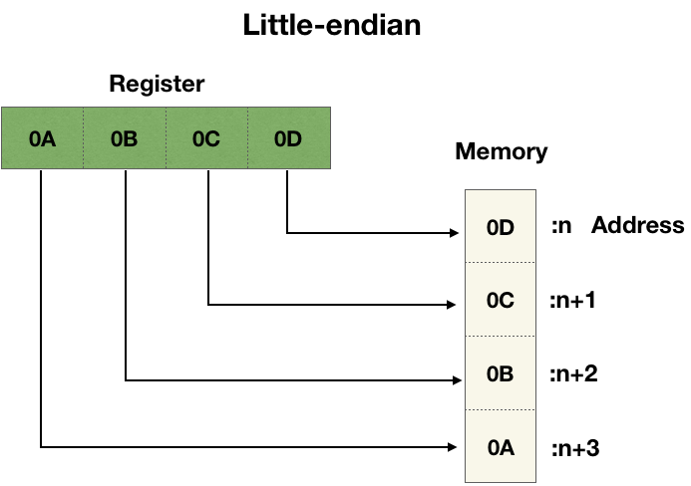
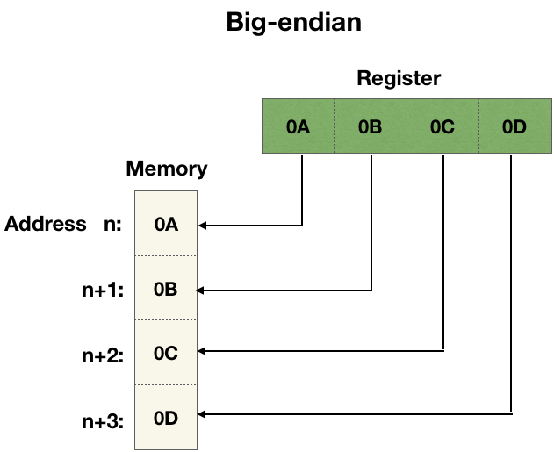
Memory banking
What are little endian and big endian mean?
With respect to 8086 MP, it is a little endian processor, which stores first byte in even memory bank and second byte in odd memory bank

Slide 12
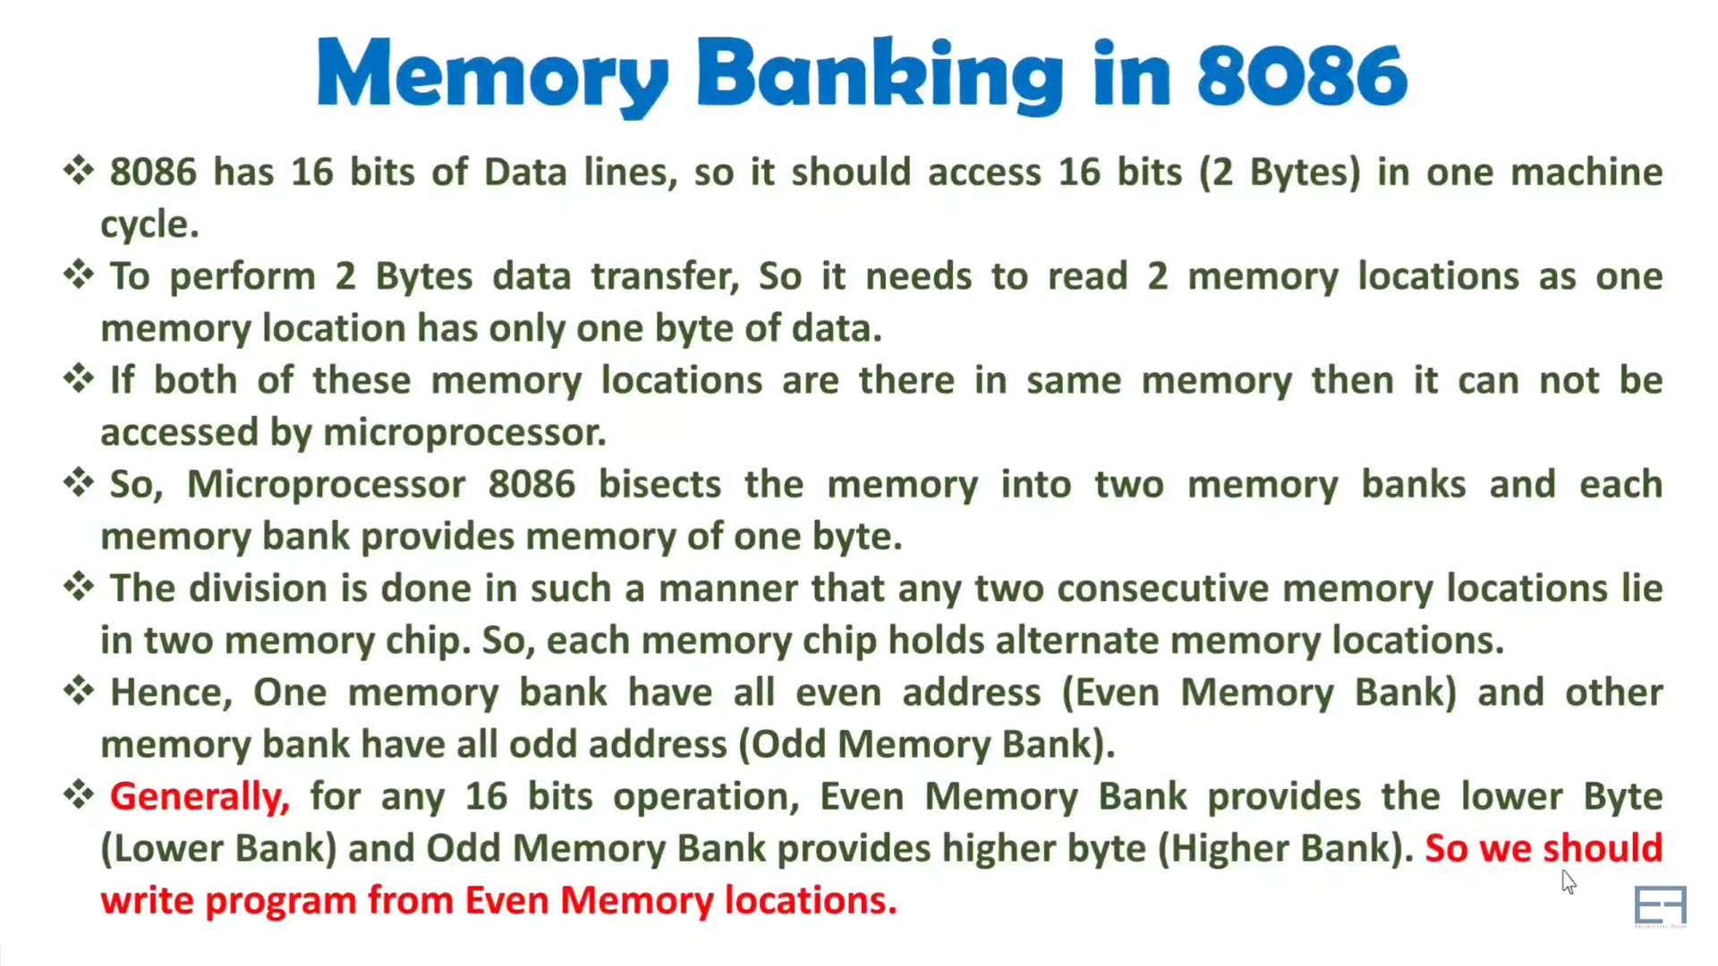
Memory banking
What are little endian and big endian mean?
With respect to 8086 MP, it is a little endian processor, which stores first byte in even memory bank and second byte in odd memory bank

Slide 13
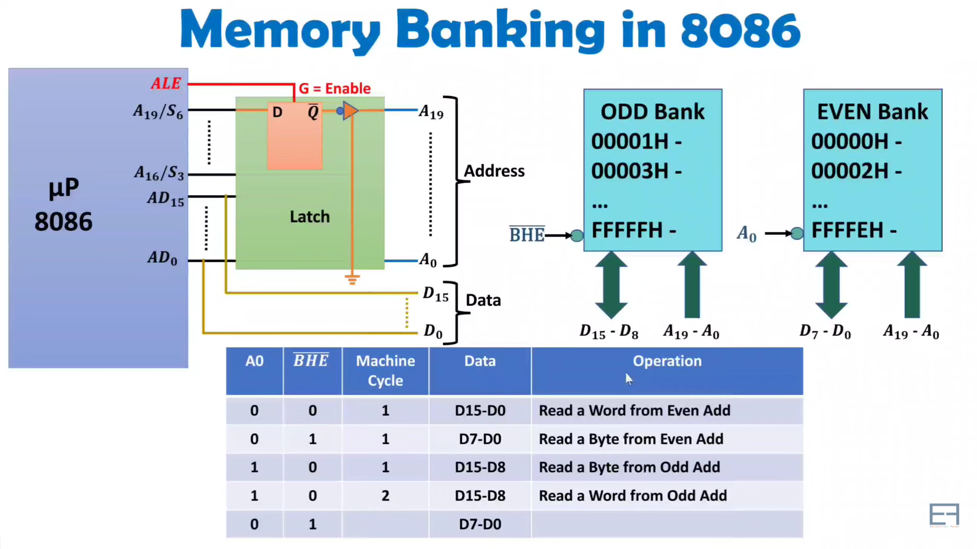
Memory banking
What are little endian and big endian mean?
With respect to 8086 MP, it is a little endian processor, which stores first byte in even memory bank and second byte in odd memory bank

Slide 14
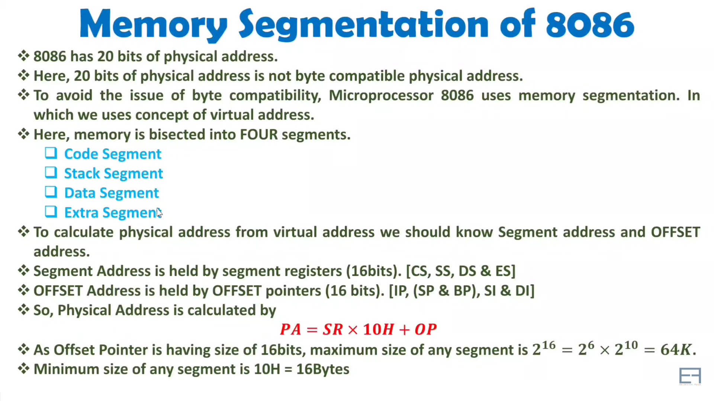

Slide 15
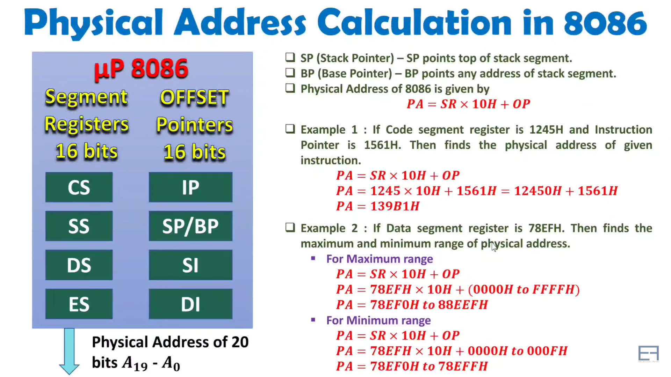

Slide 16
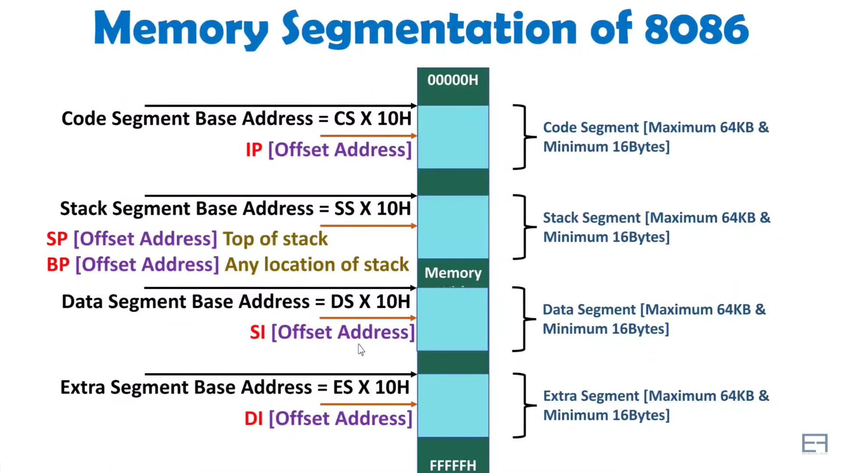

Slide 17
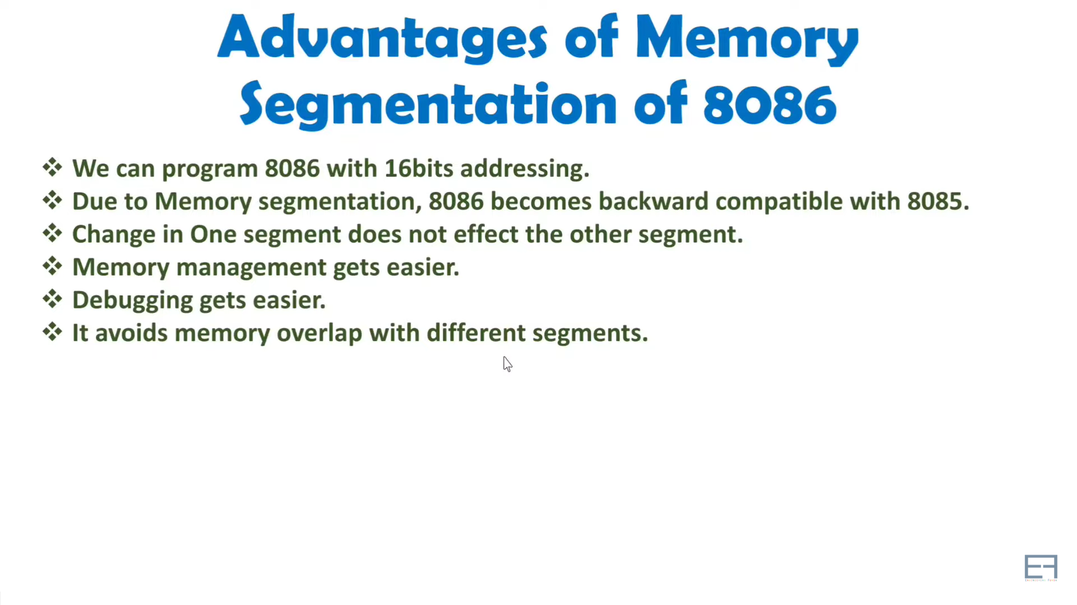

Slide 18
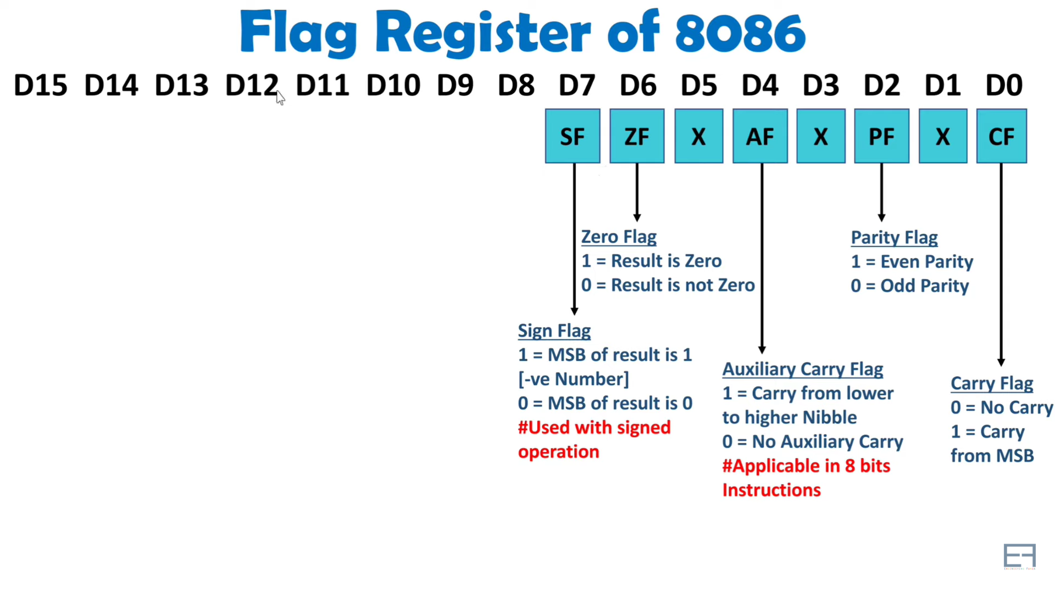

Slide 19
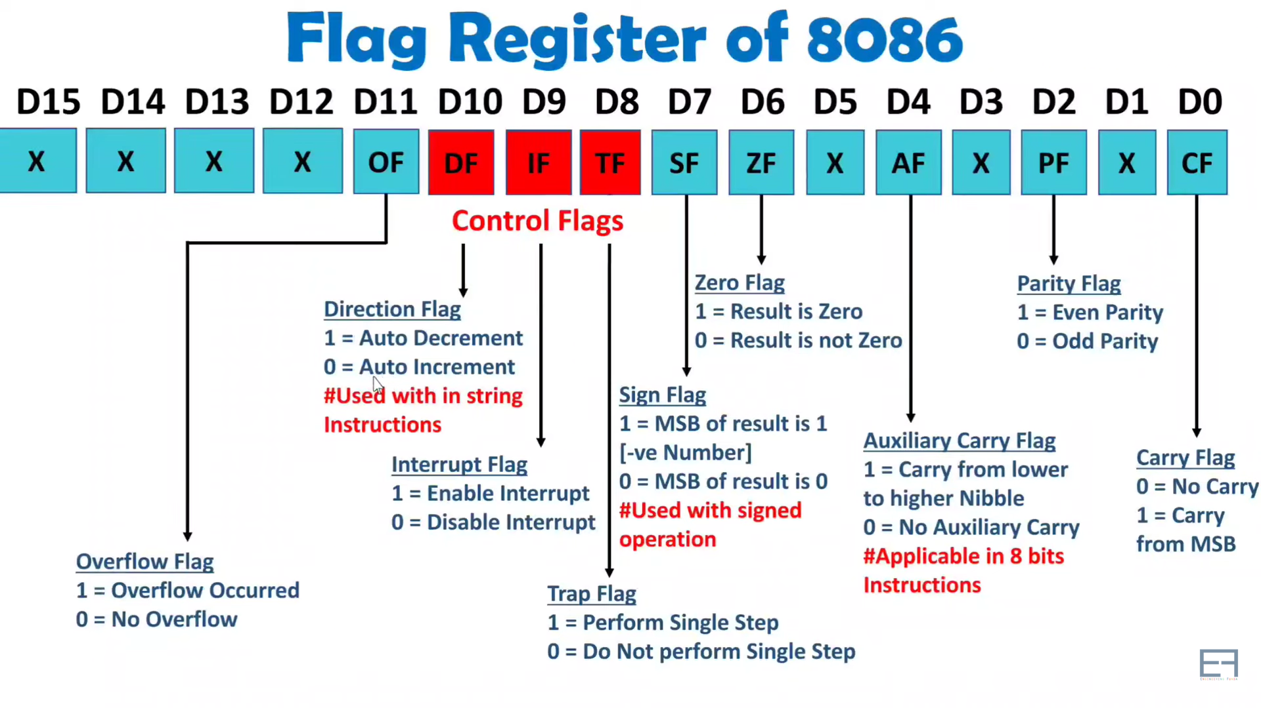

Slide 20
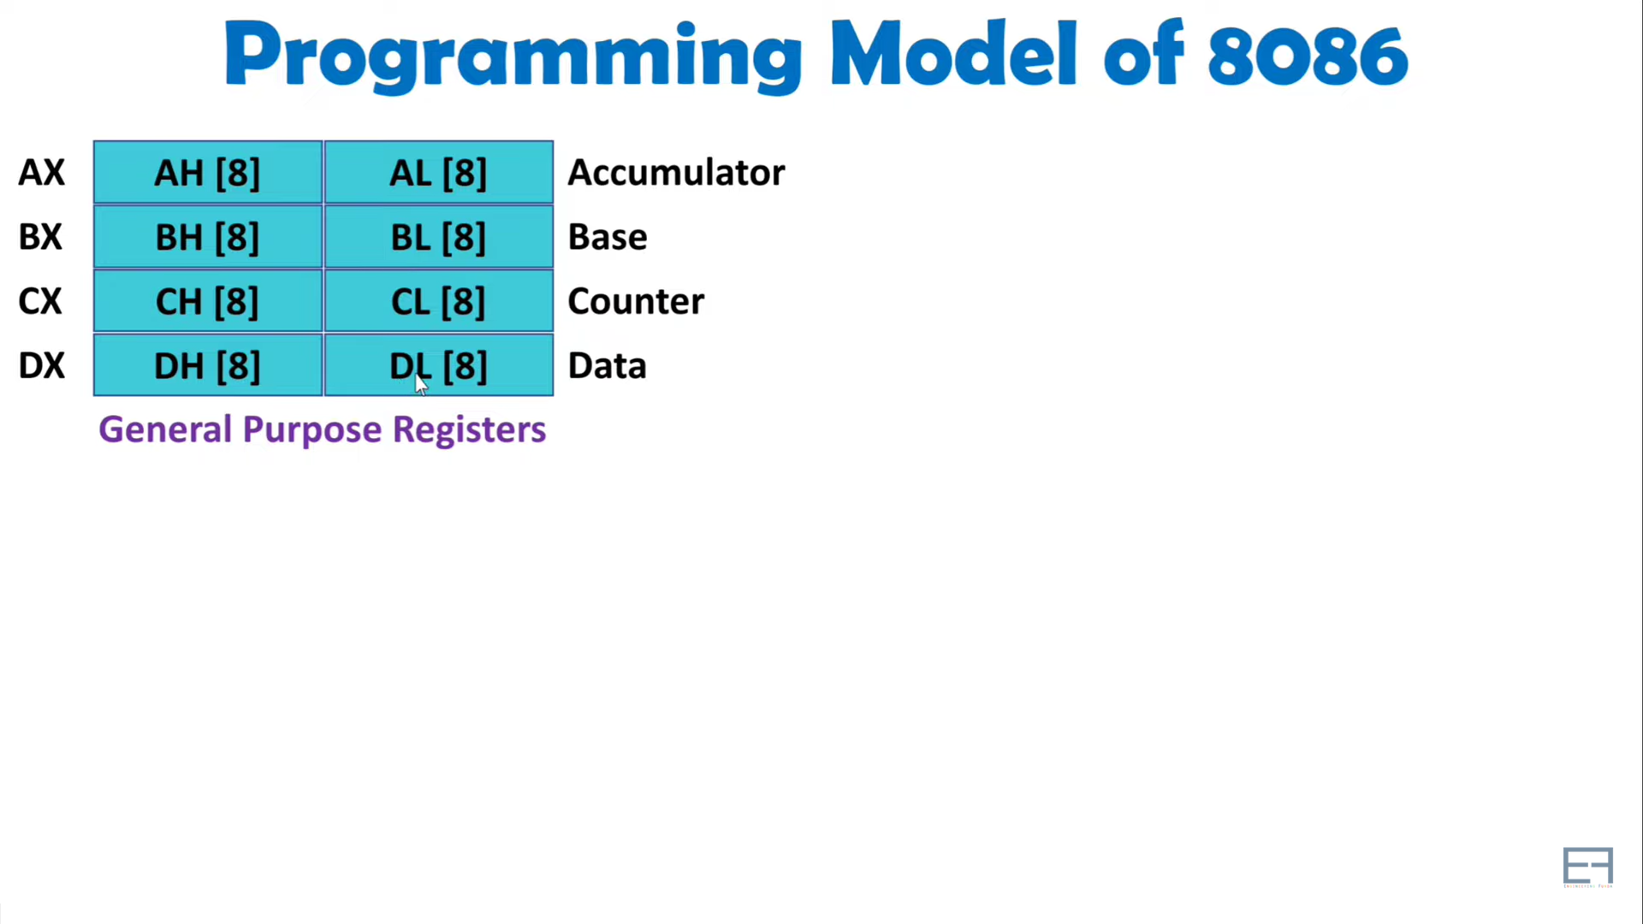

Slide 21
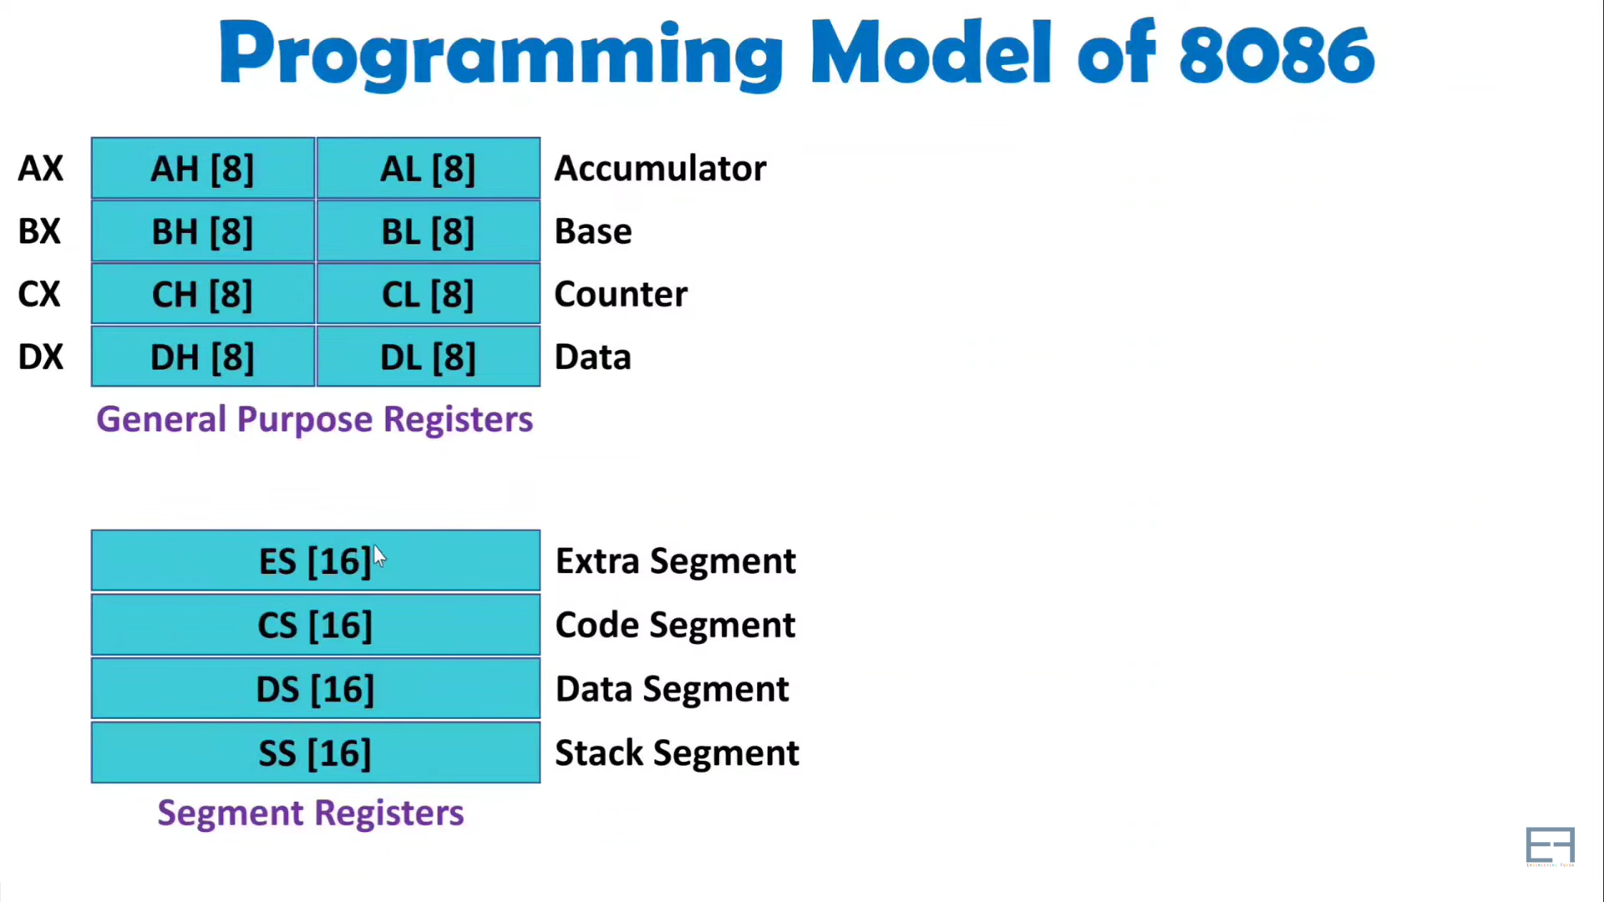

Slide 22
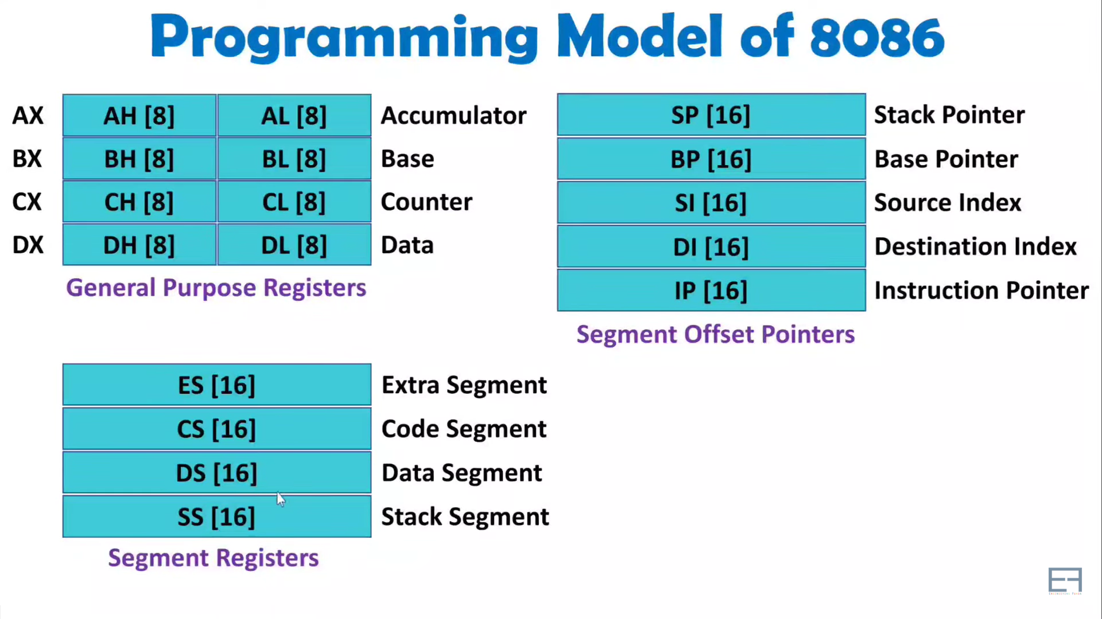

Slide 23
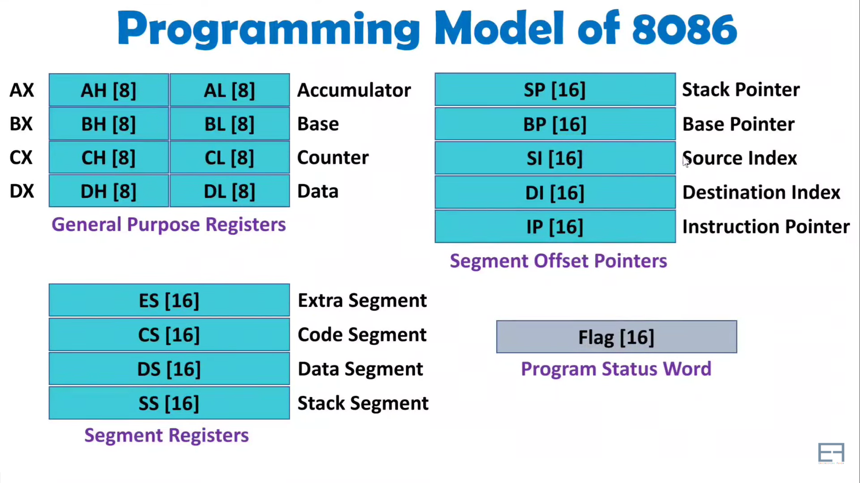

Slide 24
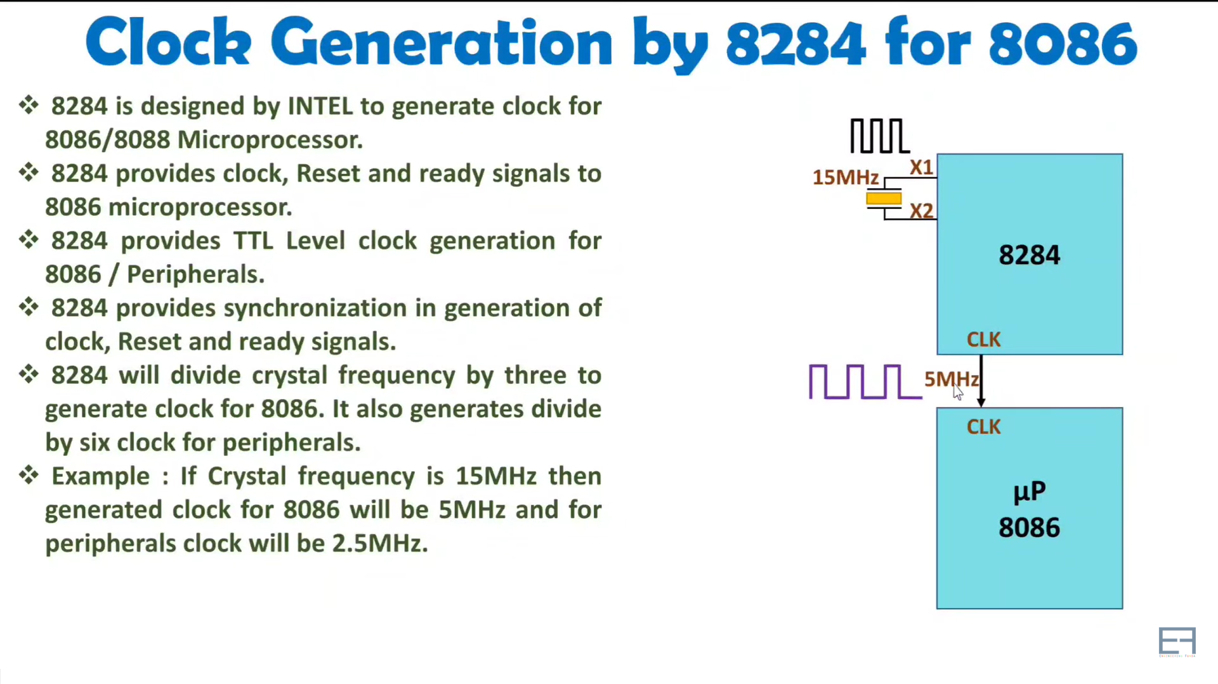

Slide 25
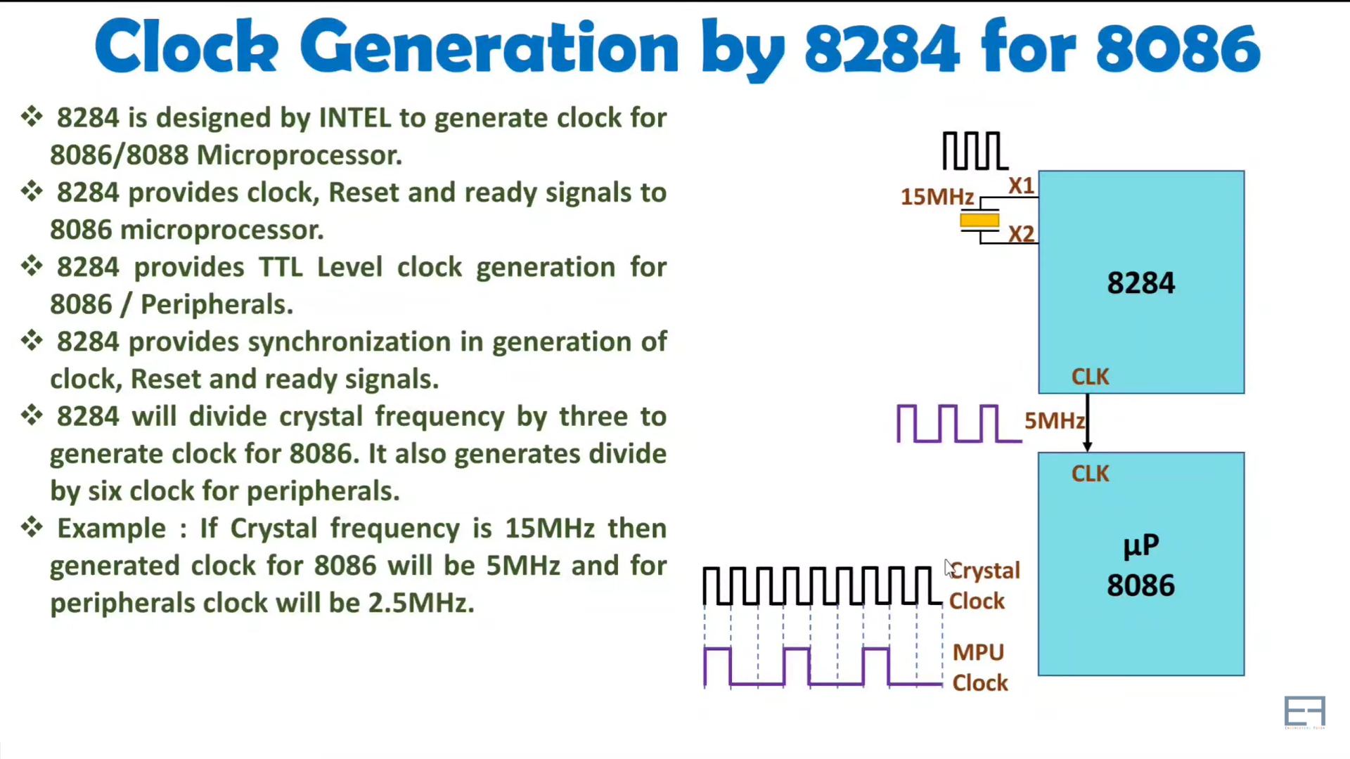

Slide 26
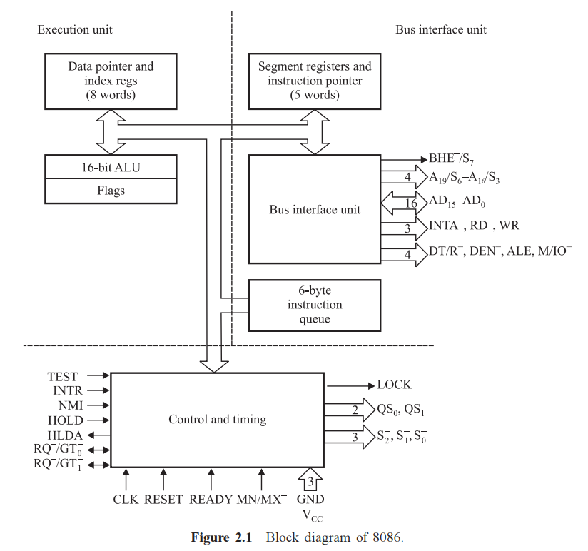
8086 architecture

Slide 27
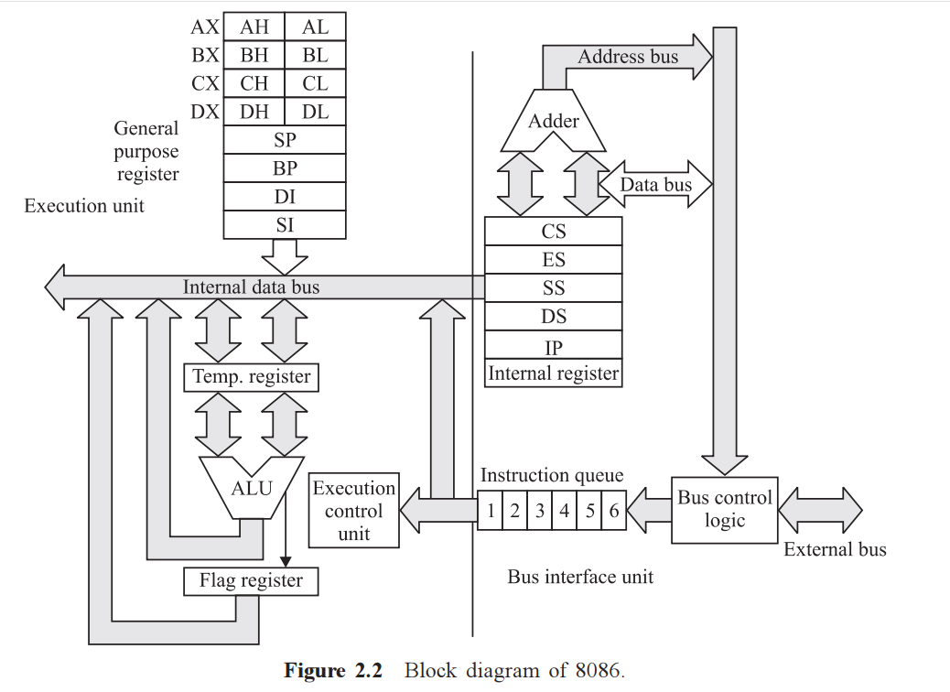
8086 architecture

Slide 28
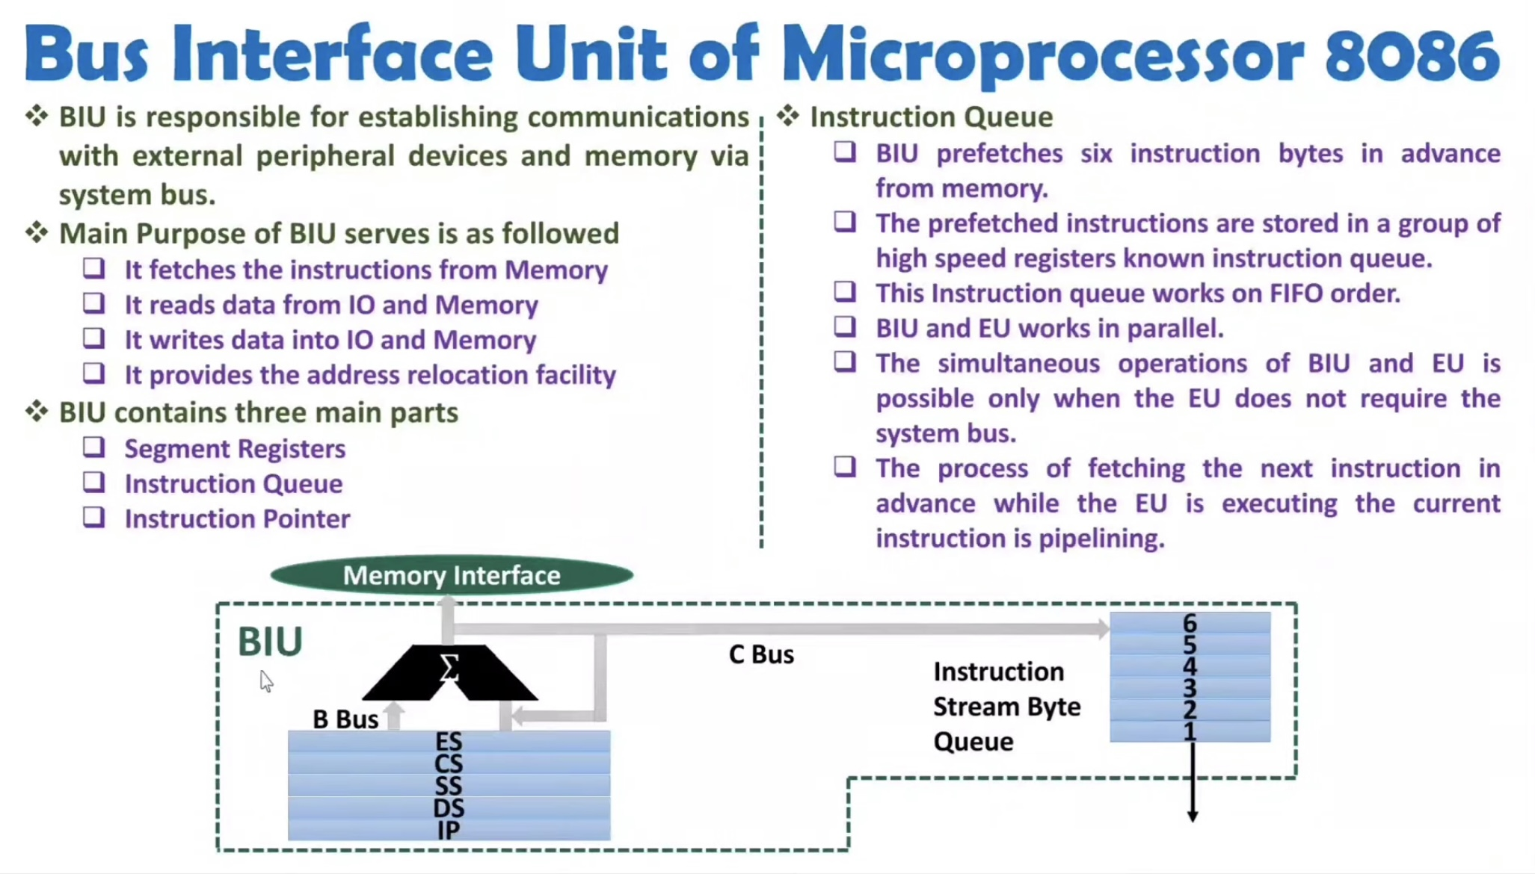


Slide 29
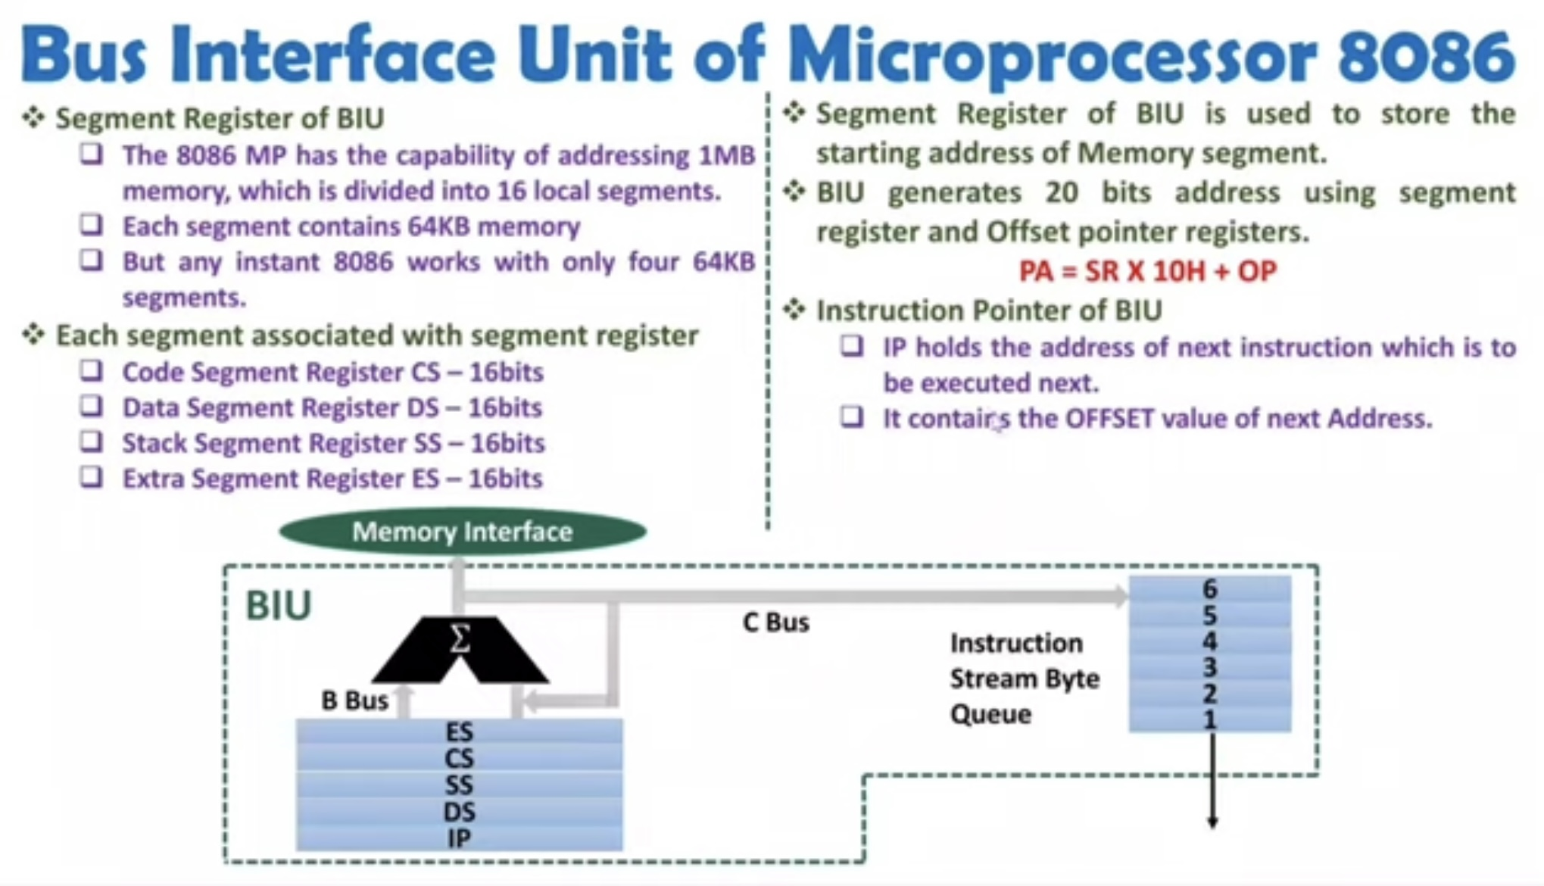

Slide 30
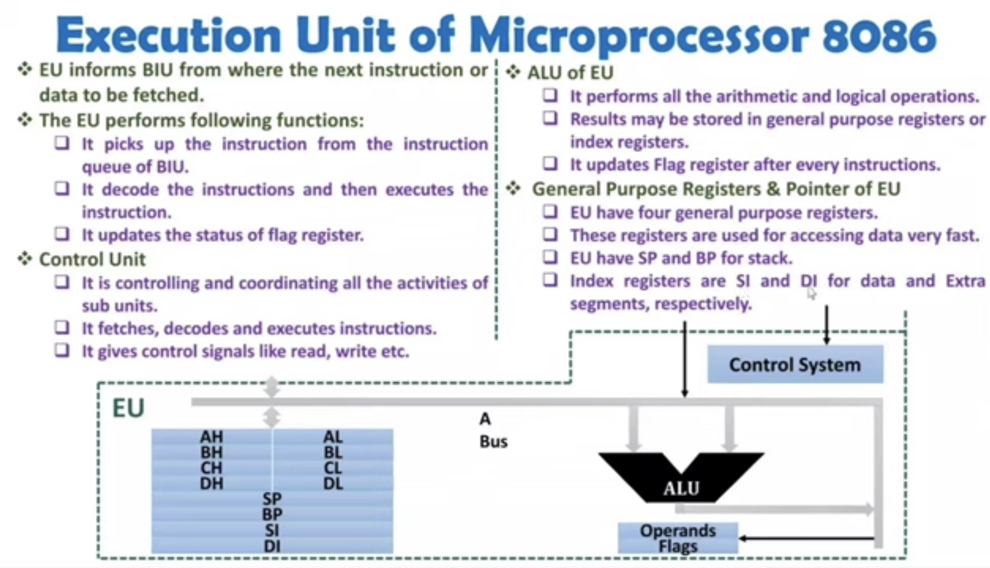

Slide 31
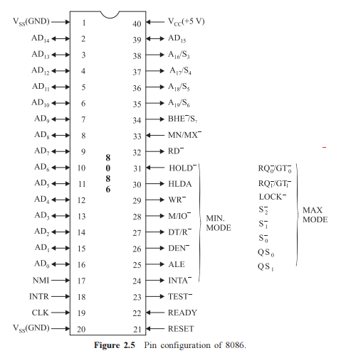
Pin diagram of 8086

Slide 32
PIN DIAGRAM IN MINIMUM MODE OF OPERATION
Connected to Vcc
Note the function of dual functional pins 24-31 when 33rd pin is connected to Vcc

Slide 33
PIN DIAGRAM IN maximum MODE OF OPERATION
Connected to GND
Note the function of dual functional pins 24-31 when 33rd pin is connected to Ground.

Slide 34
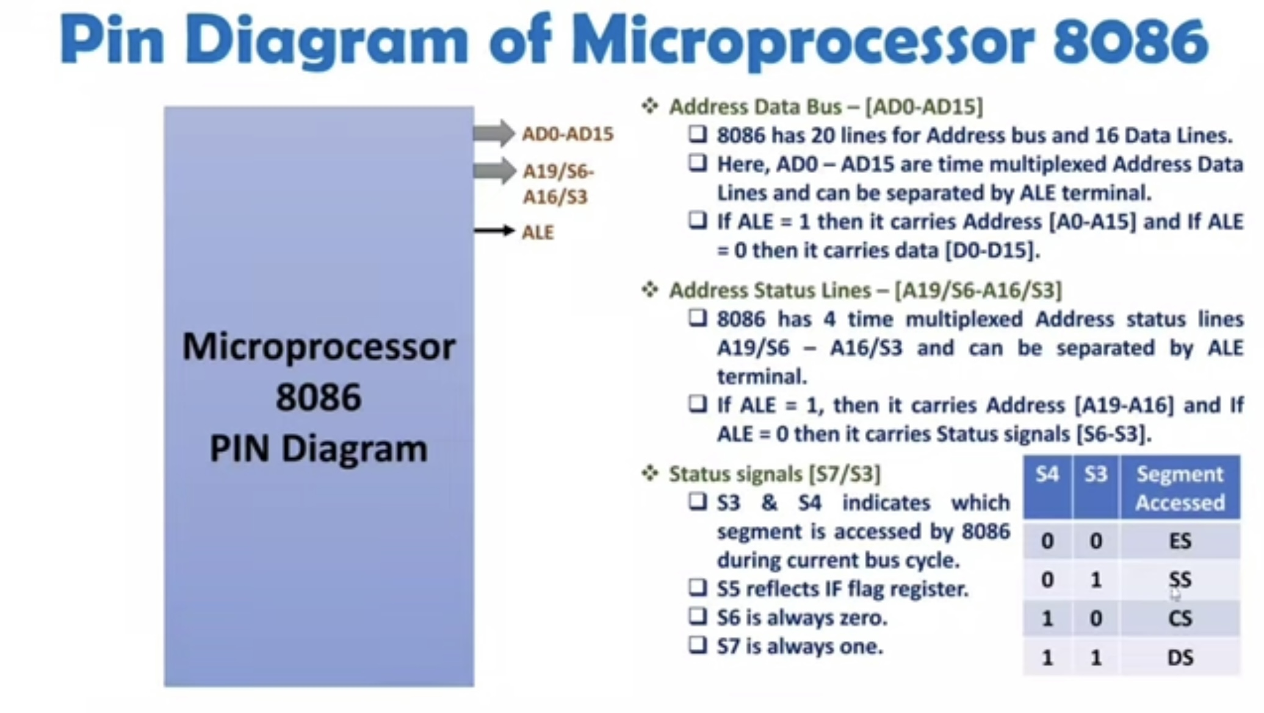

Slide 35
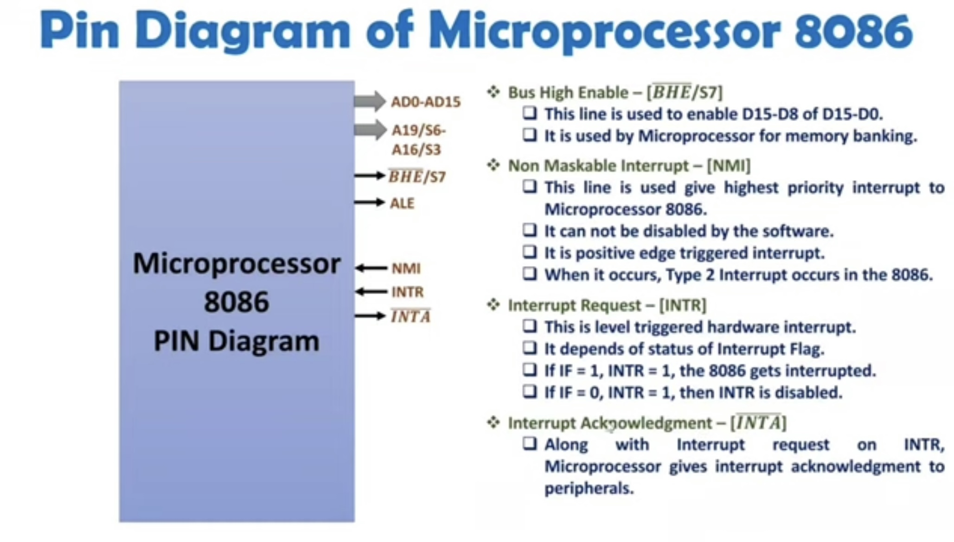

Slide 36
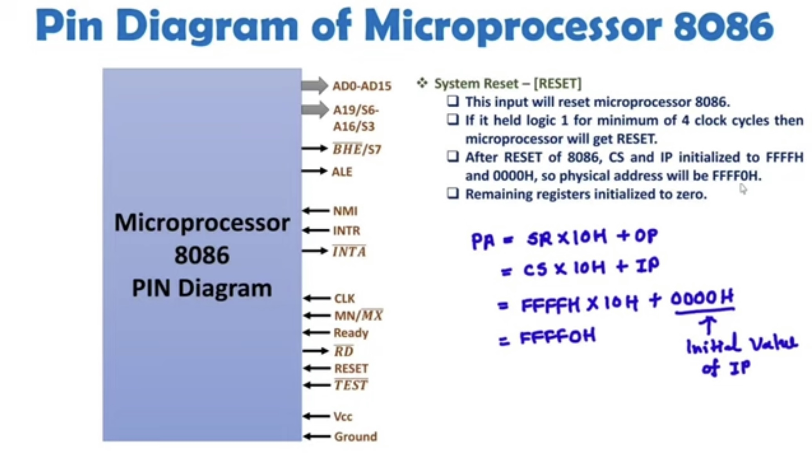

Slide 37
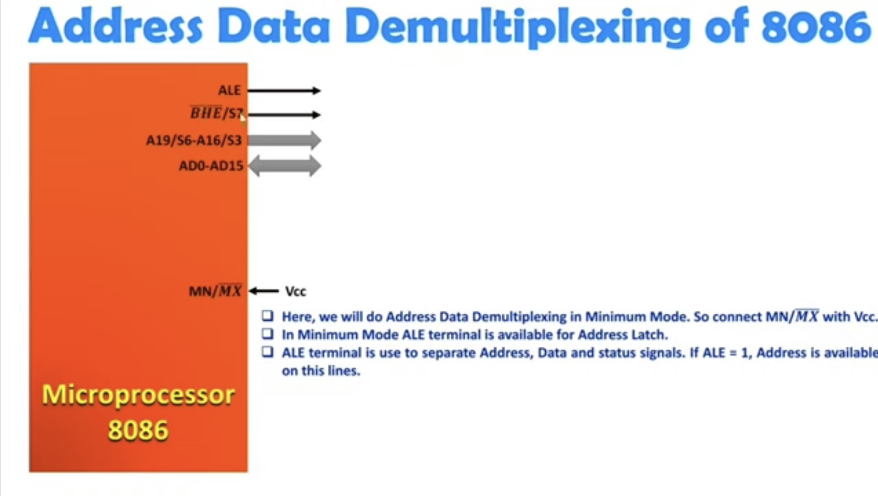

Slide 38
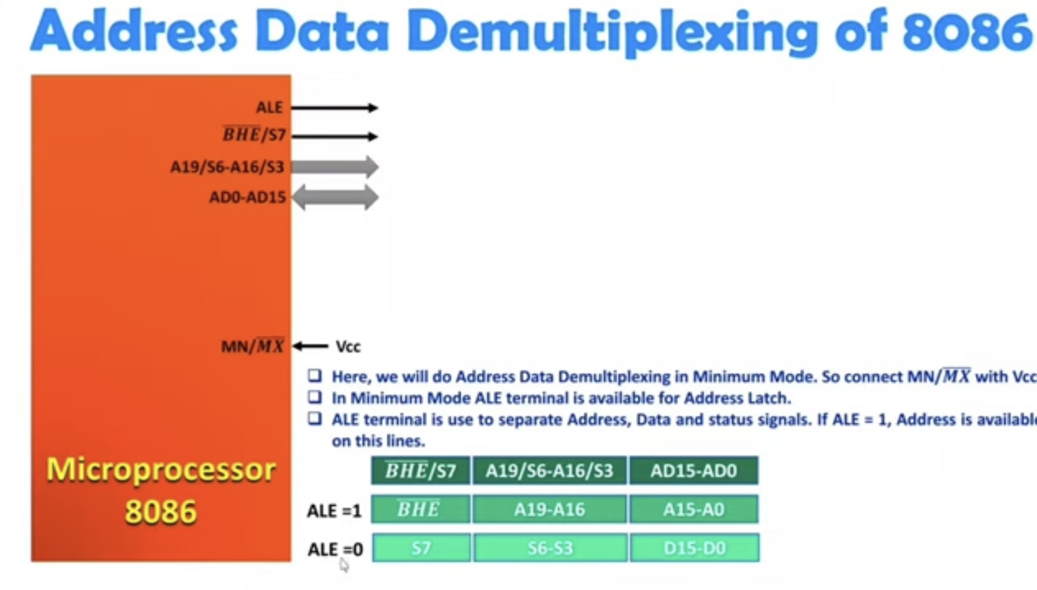

Slide 39
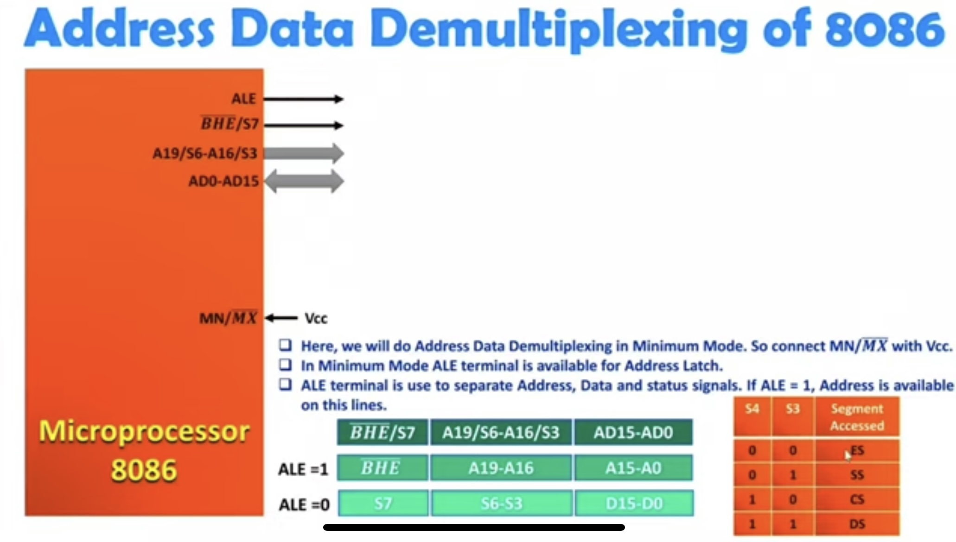

Slide 40
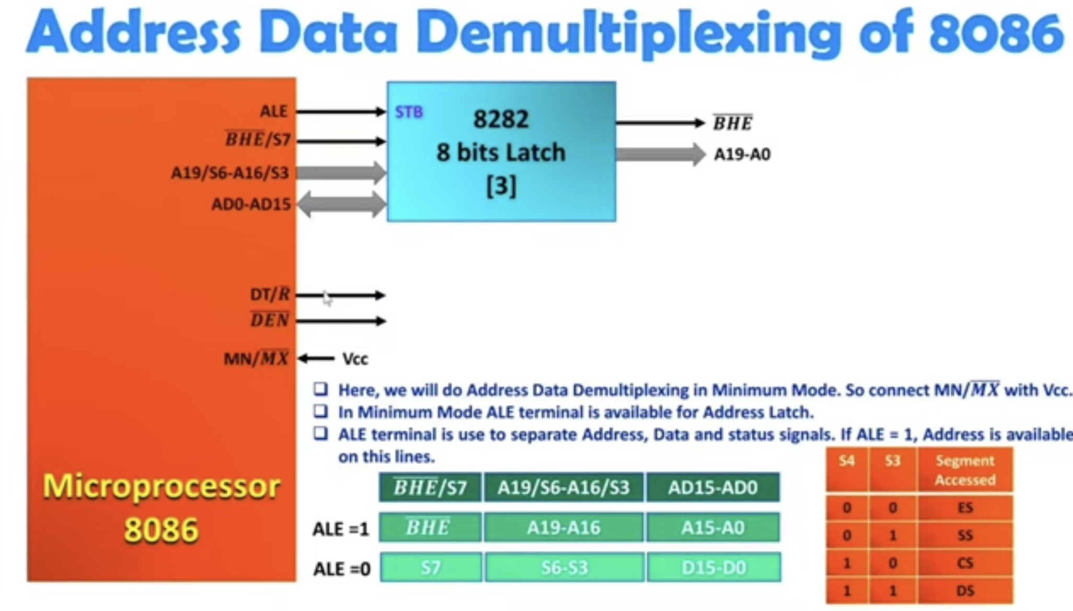

Slide 41
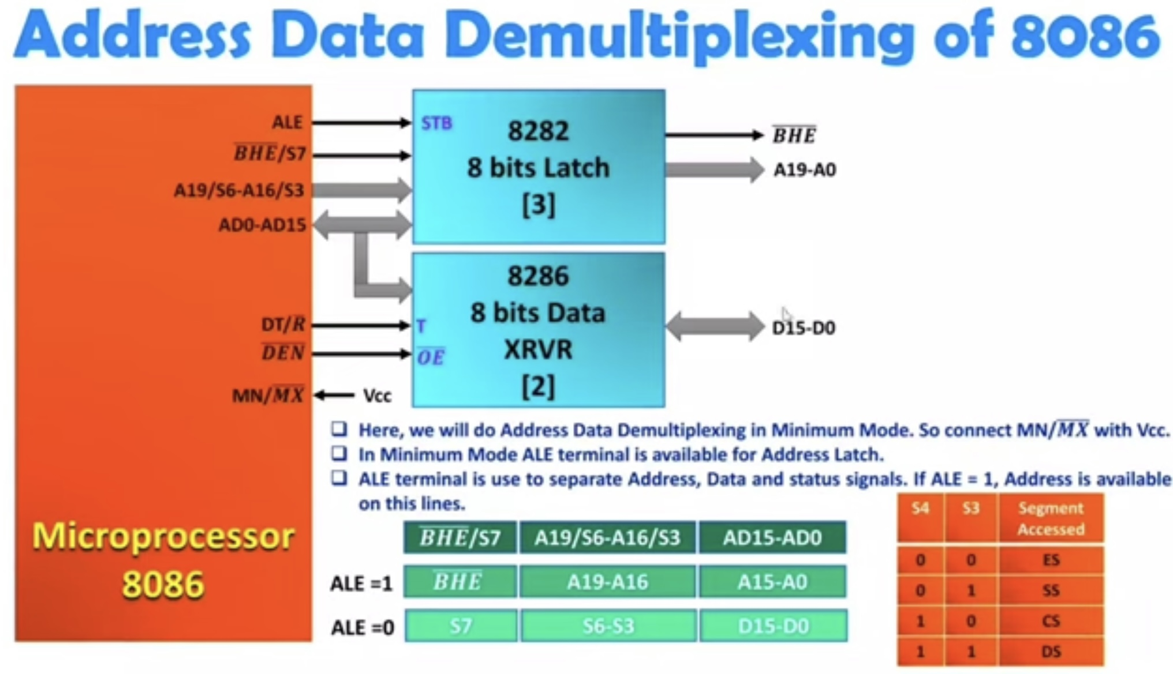

Slide 42
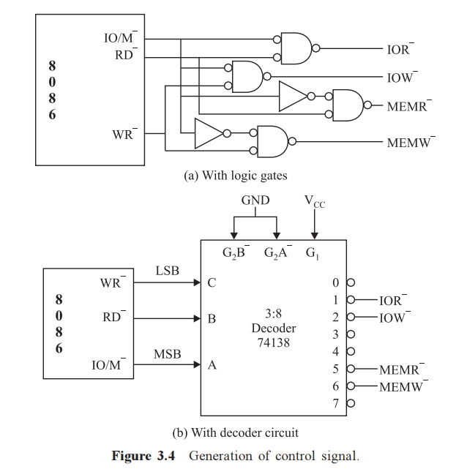
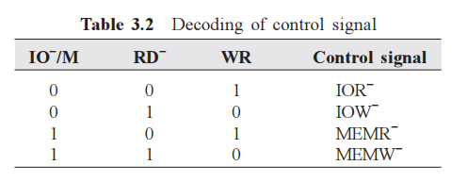
Generation of control signals

Slide 43
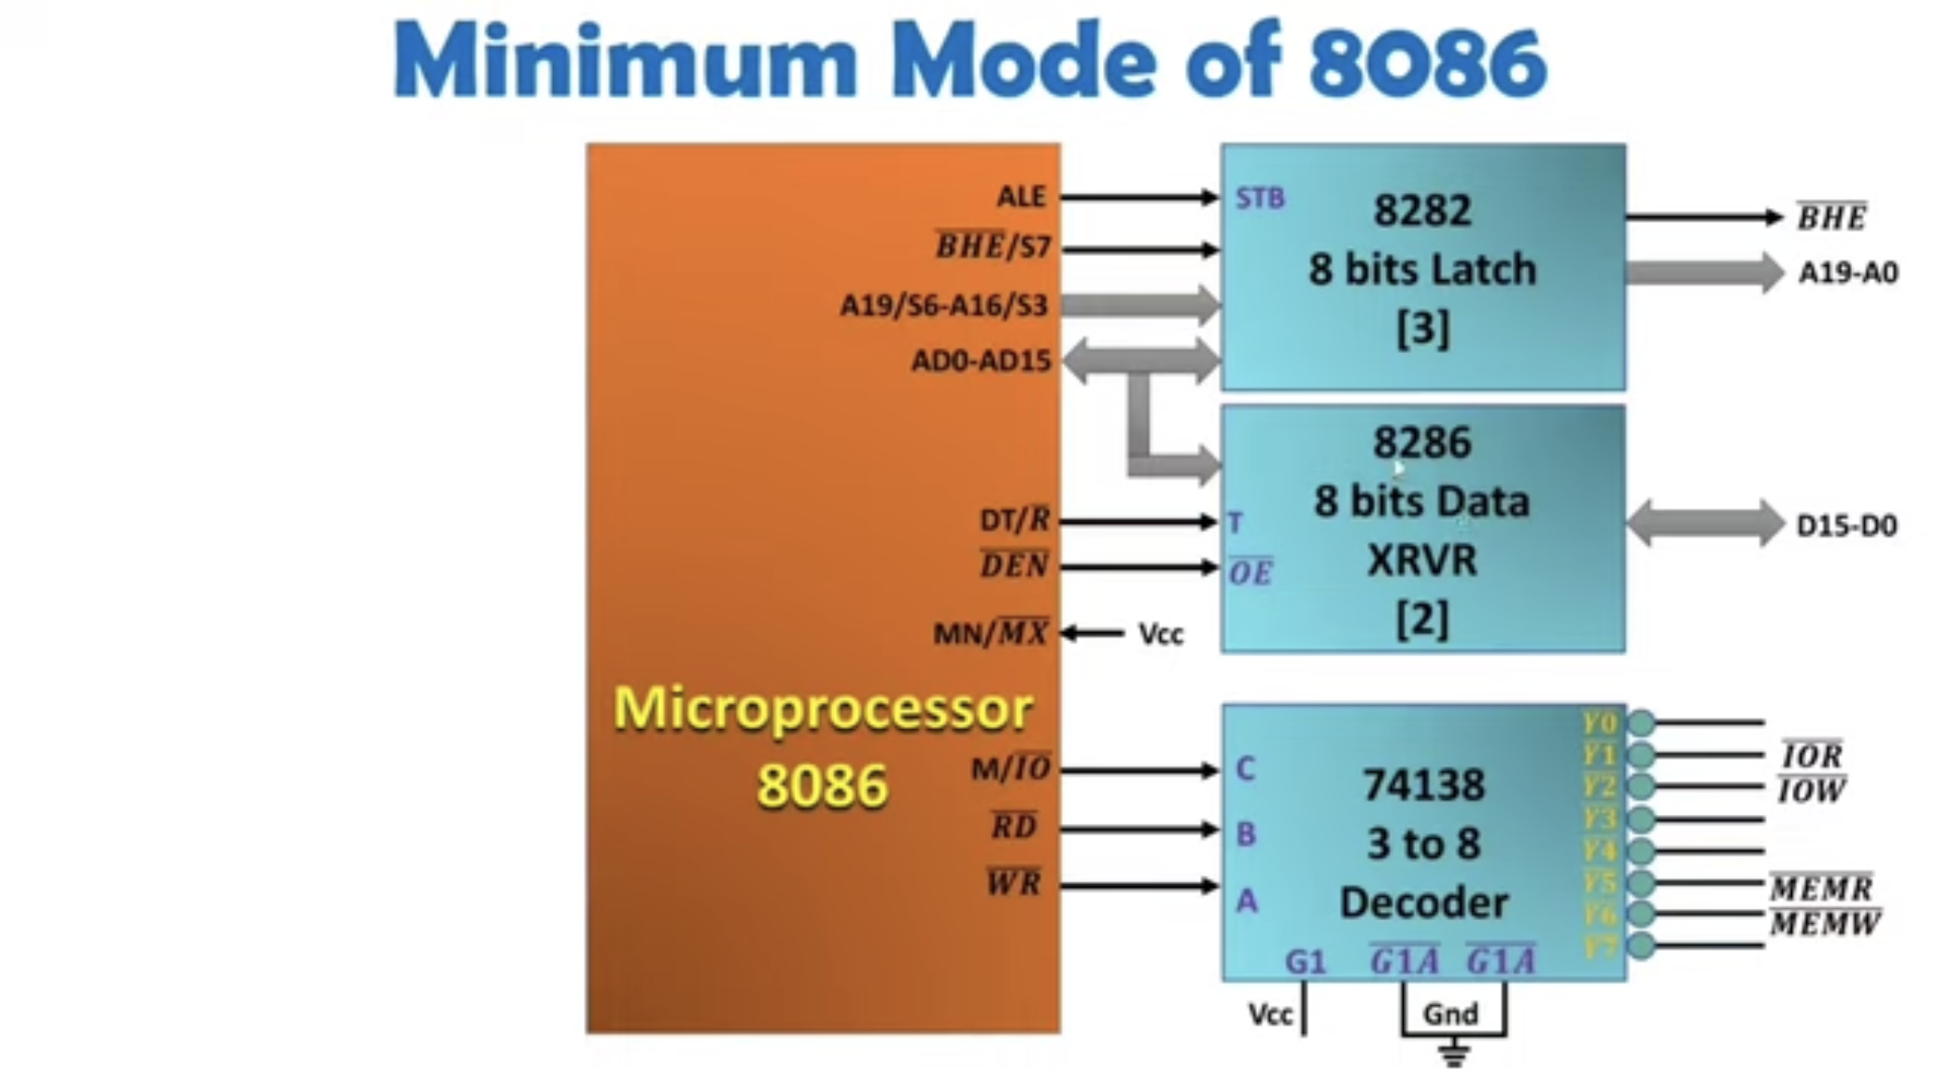

Slide 44
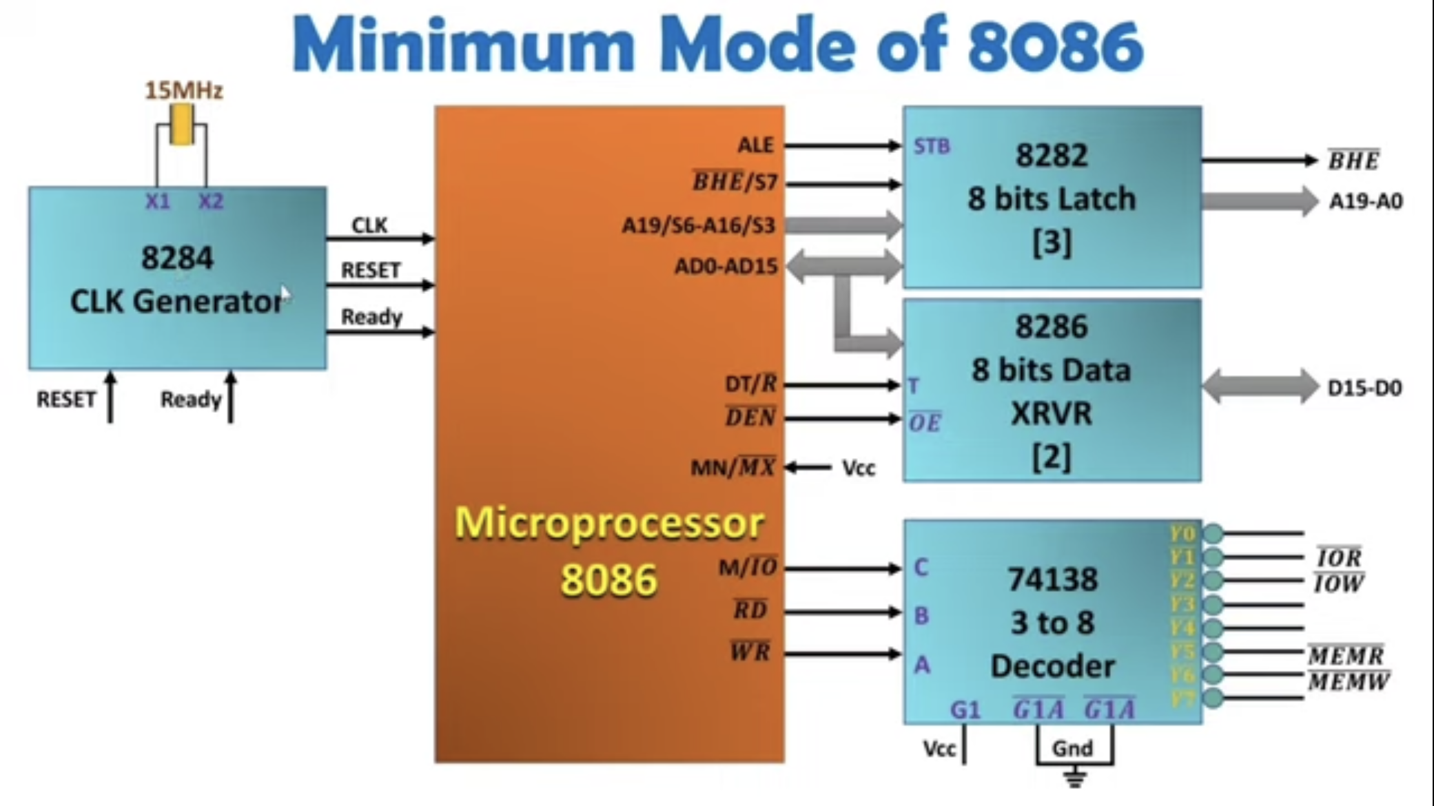

Slide 45
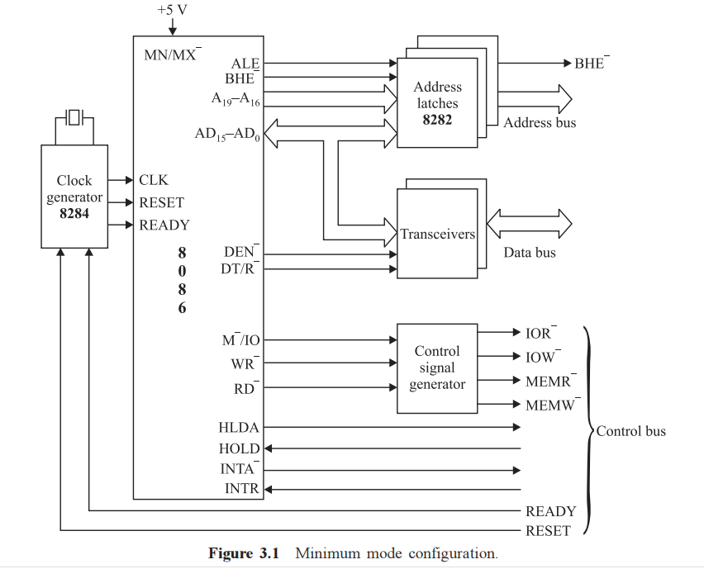
Minimum mode configuration

Slide 46
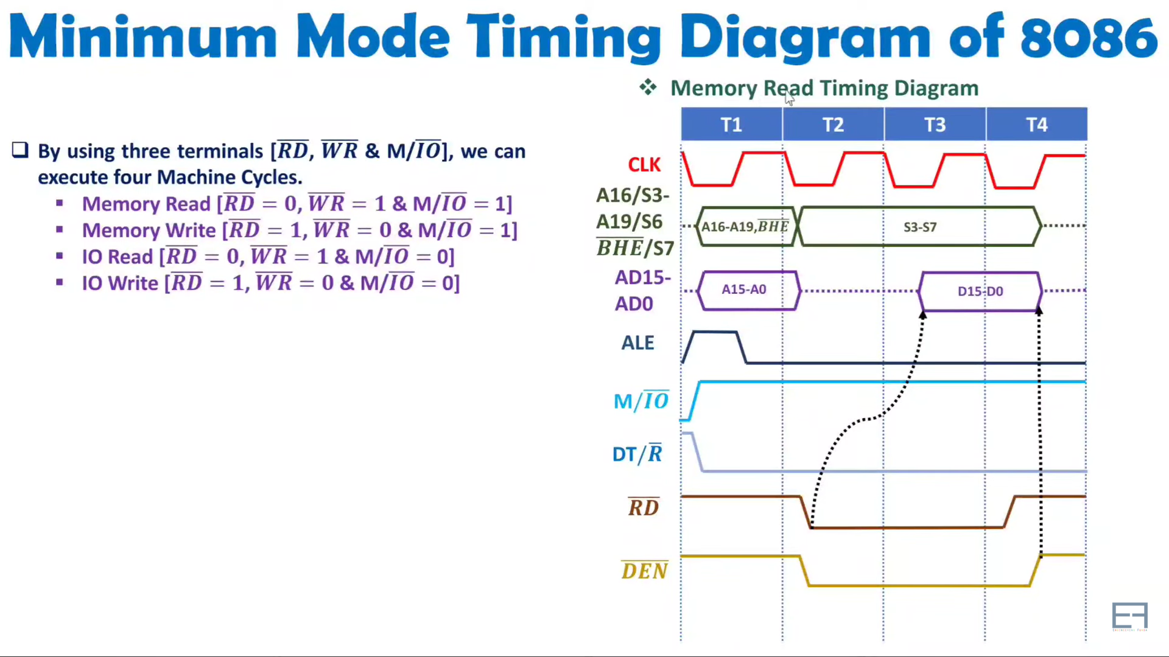

Slide 47
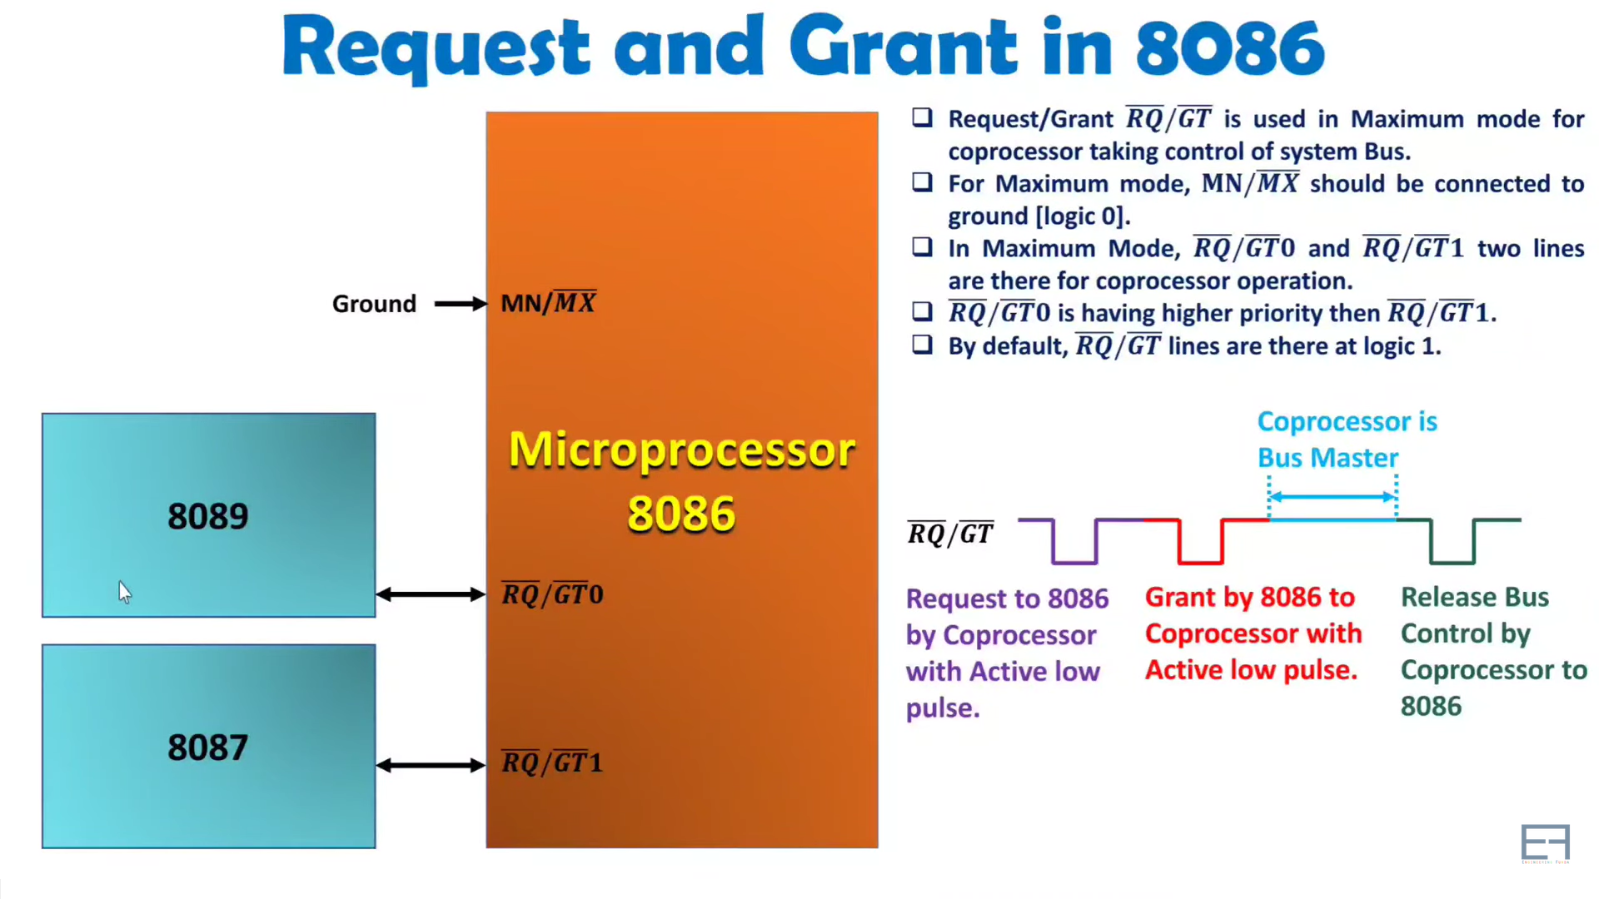

Slide 48
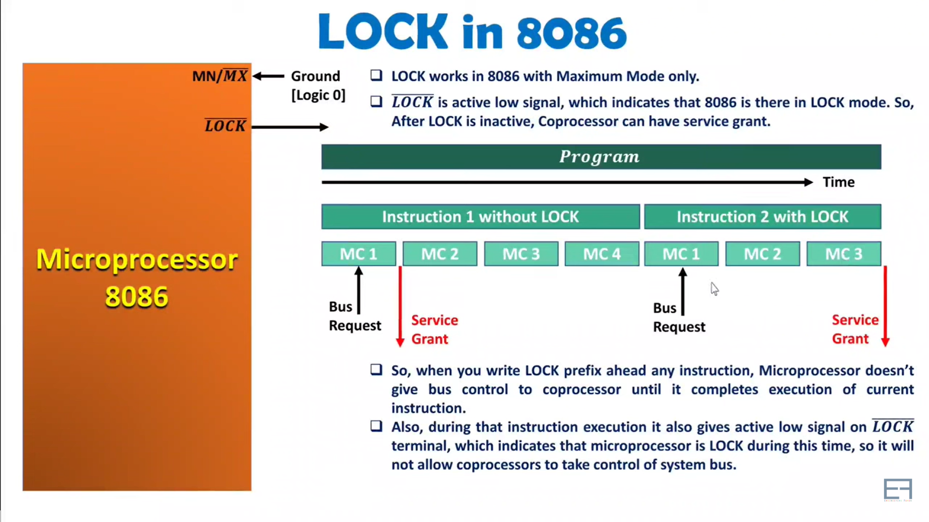

Slide 49
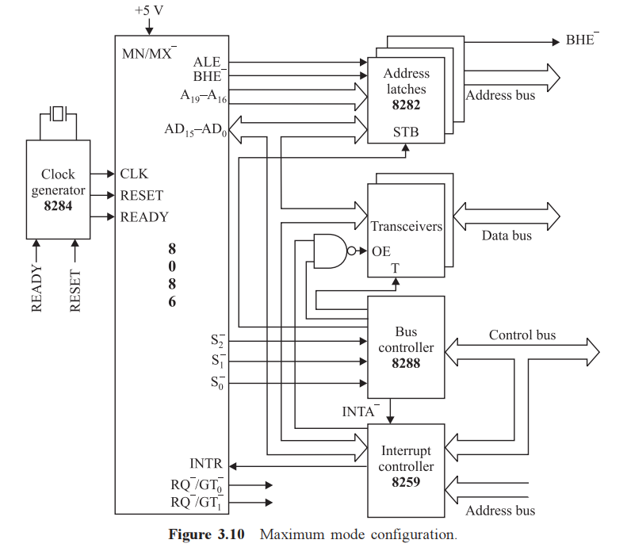
Maximum mode configuration
GND
Note here the resources like memory, address bus, data buses are shared between the processors
Remember the following:
8284 – CLK, READY, and RESET signals generator for sync. of processors
8282 – 8-bit latches (#3) to demultiplex address and ALE
8286 – 8-bit transceivers (#2) to control the data flow
8288 – Bus controller, it generates necessary control signals
8259 – Interrupt controller to control the flow of interrupts and generate INTR

Slide 50
Maximum mode configuration
GND
8288 – Bus controller, it generates the following signals
DEN
DT/R—
IORC —
IOWTC —
MWTC —
MRDC —
ALE etc.,
By using 3 status signals from 8086,
S0—, S1 —, S2 —
These signals perform the same task as that of MIN mode but not DEN is active high which needs to be inverted

Slide 51
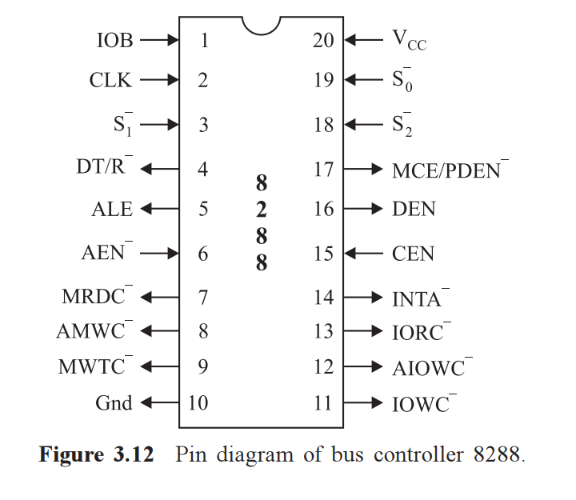
PIN DIAGRAM OF Bus controller 8288
PIN NOMENCLATURE:
IOB : IO bus mode
DT/R⁻⁻ : Data Transmit/Receive
ALE : Address Latch Enable
AEN⁻⁻ : Address Enable
MRDC⁻⁻: Memory Read Command
AMWC⁻⁻ : Advance Memory Write Command
MWTC⁻⁻ : Memory Write Command
MCE/PDEN⁻⁻ : Master Cascade/Peripheral Data

Slide 52
PIN DIAGRAM OF Bus controller 8288
PIN NOMENCLATURE:
DEN : Data enable
CEN : Control enable
INTA⁻⁻ : Interrupt Acknowledge
IORC⁻⁻ : IO Read command
AIOWC⁻⁻ : Advance IO write command
IOWC⁻⁻ : IO write command
S0⁻⁻, S1⁻⁻, S2⁻⁻ : Status signals from 8086
Vcc, Gnd: For biasing

Slide 53
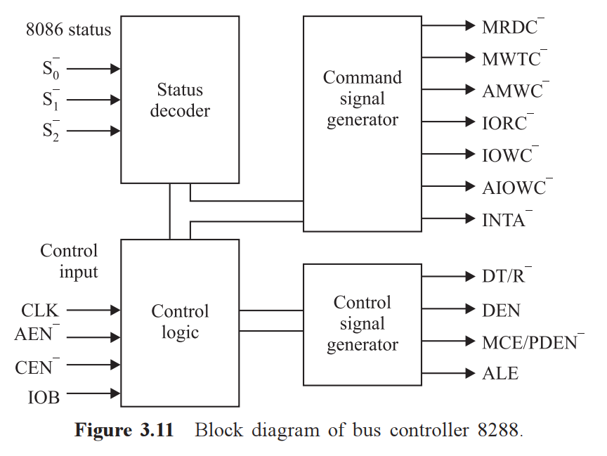
Bus controller 8288
8288 operates in two modes
IO bus mode
System bus mode

Slide 54
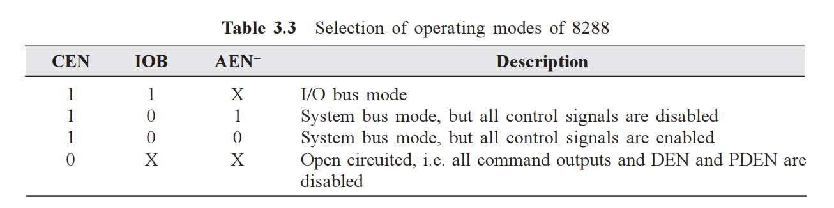
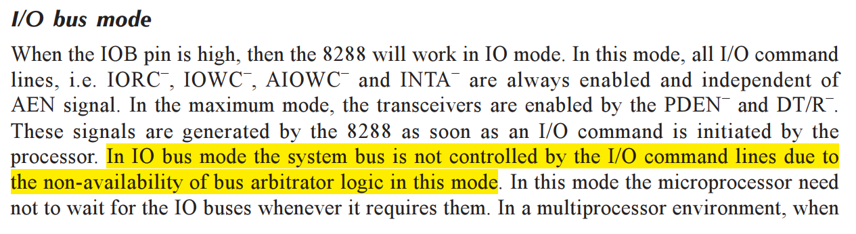
Bus controller 8288 IO bus mode

Slide 55
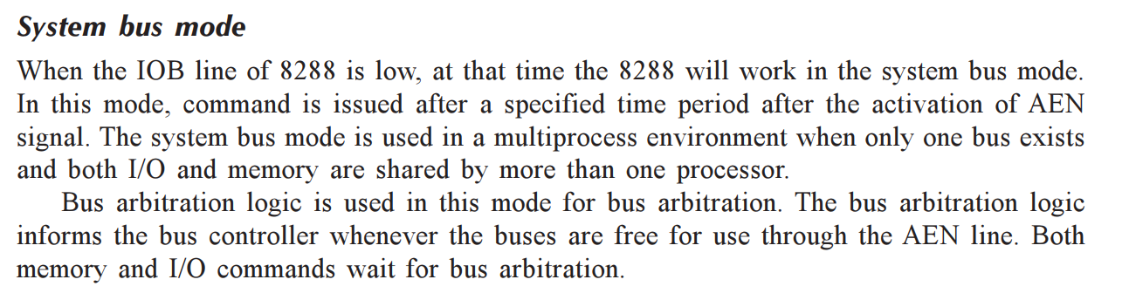
Bus controller 8288 system bus mode

Slide 56
recall on bus arbitration
Arbitration is a procedure in which a dispute is submitted, by agreement of the parties, to one or more arbitrators who make a binding decision on the dispute.
Bus Master is a device that initiates data transfer on the bus in any given time
In computer architecture, there can be one or more bus masters (eg. A DMA controller or processor)
Bus arbitration technique involves relinquishing of control over the bus by the current bus master and mastership is transferred to a subsequent bus seeking device
There are two types of bus arbitration:
Centralized Arbitration
Daisy Chaining
Polling
Independent request
Distributed Arbitration

Slide 57
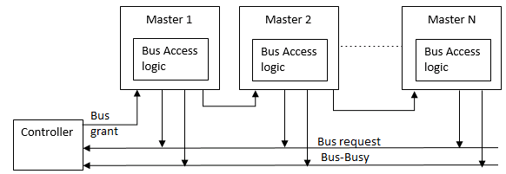
recall on bus arbitration
Centralized Arbitration
Daisy chaining
All bus master use the same line for bus request
If the bus busy line is inactive, the bus controller gives the bus grant signal
Bus grant signal is propagated serially through all masters starting from nearest one
The bus master which requires system bus, stops this signal, activates the bus busy line and takes control of system bus

Slide 58
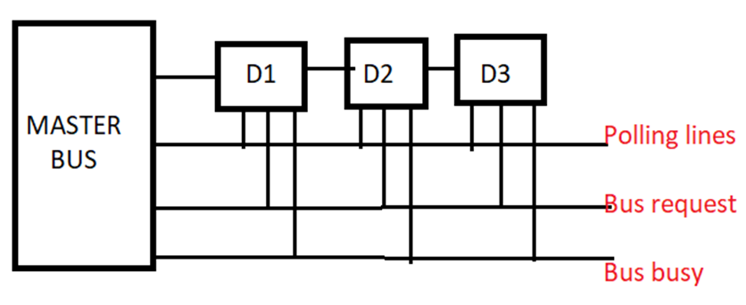
recall on bus arbitration
Centralized Arbitration
Polling
There are log n polling lines for n devices connected to the master
Master polls by placing device ID on the polling lines
Master decides the priority, once bus grant signal is achieved by a device, then the bus master marks bus busy

Slide 59
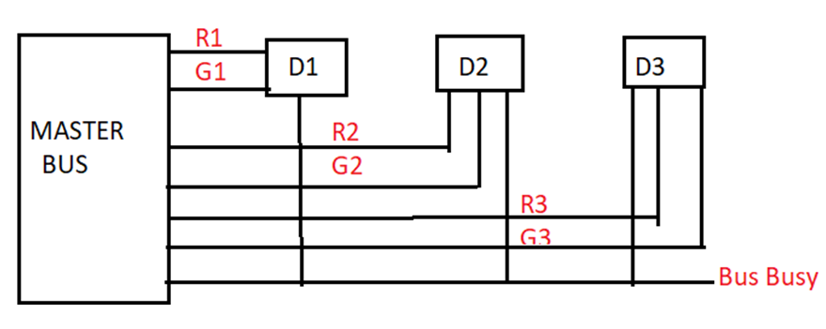
recall on bus arbitration
Centralized Arbitration
Independent request
Every device has its own dedicated request and grant lines
Priority is assigned by the bus master

Slide 60
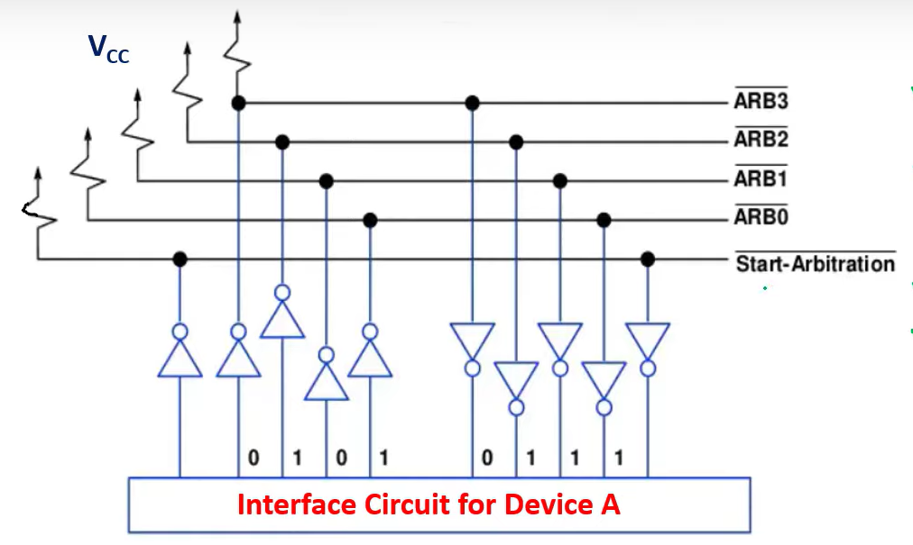
recall on bus arbitration
Distributed Arbitration

Slide 61
recall on bus arbitration
Distributed Arbitration
There is no central bus arbitrator here and so is very reliable
All the devices take part in selection of next bus master
All the devices will be assigned a 4 bit arbitration ID
When the multiple bus requests arise, then OR operation of IDs of contesting devices is generated and made available on the arbitration line
Each device then, compares the values in the arbitration line with that of its own ID
Comparison starts from MSB (4th bit) and proceeds towards LSB (0th bit)
While comparing if there is a difference is detected then the device manipulates the bus arbitration line values by passing ‘0’ to the corresponding bits and successive lower bits
Again the next device compares its ID with the new value on the arbitration lines by OR operation

Slide 62
recall on bus arbitration
Distributed Arbitration
If any device ID matches with the result of OR operation then that device gains the bus (becomes bus master)
Example:
Devices with IDs 0101 and 0110 are contesting for bus mastery
Allocation of bus by distributed arbitration
OR operation of IDs: 0111
Device 0101 compares 0111 (0101 | 0111 = 0100 → new arbitration value)
Device 0110 does OR operation with 0100 (0110 | 0100 = 0110 → matching with Device ID 0110)
Hence Device 0110 becomes the bus master

Slide 63

Bus controller 8288
0

Slide 64

Memory interfacing in Mn mode
Here the required control signals, MEMR‾, MEMW‾, are generated by either 3:8 decoder or the control signal generator
A₁ - A₁₉ determine the addresses in odd or even bank
A₀ along with BHE‾ determine the chip selection for odd or even bank
Once the bank is selected and data path is decided by the DT/R‾ and DEN‾ then the data flows in/out of memory
M/IO‾

Slide 65

Memory interfacing in MX mode

Slide 66

Memory interfacing in MX mode

Slide 67


Memory interfacing in MX mode
Stage-III: Interfacing diagram:
Here the bus controller 8288 IC generates the necessary command signals, $\overline{MRDC}$, $\overline{MWRC}$ and $\overline{AMWC}$
Also it defines the data path by DT/ $\overline{R}$ and $\overline{DEN}$signals based on status signals from x86

Slide 68

Memory interfacing in mx¯ mode
Here the required control signals, MRDC‾, MWTC‾, are generated by 8288 controller
A₁ - A₁₉ determine the addresses in odd or even bank
A₀ along with BHE‾ determine the chip selection for odd or even bank
Once the bank is selected and data path is decided by the DT/R‾ and DEN‾ are generated by the bus controller and Txn/Rxn occurs

Slide 69

Control signals gen. in Mn/mx¯ mode
A₀ | BHE‾ | Control signal | Operation
0 | 0 | MEMR‾ / MRDC‾ | Read a word from lower bank (16 bits)
0 | 1 |  | Read a byte from lower bank (8 bits)
1 | 0 |  | Read a byte from upper bank (8 bits)
1 | 0 |  | Read a word from upper bank (16 bits); Starts with upper bank and ends in lower bank
0 | 1

Slide 70
Control signals gen. in Mn/mx¯ mode
A₀ | BHE⁻⁻ | Control signal | Operation
0 | 0 | MEMW‾ / MRTC‾ | Write a word in lower bank (16 bits)
0 | 1 |  | Write a byte in lower bank (8 bits)
1 | 0 |  | Write a byte in upper bank (8 bits)
1 | 0 |  | Write a word in upper bank (16 bits); Starts with upper bank and ends in lower bank
0 | 1

Slide 71

mx¯ mode bus cycles of 8086 mp
MEMORY READ OPERATION
Note in MX‾ mode, the status signals needs to active for bus controller to generate CTRL signals
8288 generates DT/R‾, DEN‾, and ALE‾ control signals
Also, it generates MRDC‾ command signal
Once the DEN‾ is passed, the data from MEM is read after a certain time delay (bus transit time)
Once the data is read, the DEN‾ becomes high, status code become inactive, completing the memory read operation

Slide 72

mx¯ mode bus cycles of 8086 mp
MEMORY WRITE OPERATION
T-states correspond to DEN‾ is low, DT/R ‾ is high, WRITE is low
Here is there is no time lag in provision of data to the data bus as the processor readily supplies the data once addresses are available in address bus
Other things are similar to memory read operation of MX‾ mode

Slide 73
Addressing modes of 8086 mp
Addressing modes of 8086
Data addressing modes (all of 8085)
Address addressing modes

Slide 74
Addressing modes of 8086 mp
Addressing modes of 8086
Data addressing modes (all of 8085)
Address addressing modes

Slide 75
Data Addressing modes
IMMEDIATE ADDRESSING MODE
The instruction itself contains the data, which is source data only
Unlike 8085, there is no letter ‘I’ is used in an instruction to symbolize immediate value
Examples are:
MOV AX, 2500H
MOV AL, 05H
Here the general purpose registers are used to store the immediate data
The length of the data should be accommodated by the register, which is to be taken care of
Data can of 8 bits or 16 bits and so is the register selection either half of a register or a full register
Remember: All registers in 8086 are 16 bits wide, also note, segment registers CANNOT store data, as they have segment addresses

Slide 76
Data Addressing modes
REGISTER ADDRESSING MODE
One of the general purpose registers are used as the operands
The data from source register is copied into the destination register
The length of register selection should be equal between source and destination operands
8- or 16- bit registers are valid operands for register addressing mode
Examples:
MOV AX, CX
MOV AH, AL
MOV SI, DX
Segment registers can never be used for data transfer operations

Slide 77

Data Addressing modes
DIRECT ADDRESSING MODE OR THE DISPLACEMENT ONLY ADDRESSING MODE
Here the 16-bit memory address or 8-bit IO address is mentioned in the instruction itself as one of the operands
The data shall go from/to the specified address
Examples
MOV BL, [2000H]
MOV [1234H], DL
By default, the data presented is pointed by data segment
If we need to point data in some other segment,
then, segment override prefix should be added
Examples: MOV BL, ES: [2000H]; MOV CS: [1234H], DL etc.,

Slide 78
Data Addressing modes
REGISTER INDIRECT ADDRESSING MODE
Used in concern with memory and IO
Here, the memory addresses are pointed by index registers or pointers or base register
These registers are written inside square brackets
The 4 forms of this AM are:
MOV AX, [BX]
MOV AX, [SI]
MOV AX, [DI]
MOV AX, [BP]
The 4 forms of this AM refer the word at offset found in BX, BP, SI or DI

Slide 79
Data Addressing modes
REGISTER INDIRECT ADDRESSING MODE
Here [SI], [DI] and [BX] modes use DS by default and [BP] use SS by default
If suppose, segment override is needed, it can be accomplished by using the override mechanism by mentioning the override prefix symbols
Examples:
MOV AX, CS: [BX]
MOV AX, DS: [BP]
MOV AX, ES: [SI]
MOV AX, ES: [DI]

Slide 80


Data Addressing modes
BASE ADDRESSING MODE
Here the 8-/16-bit displacement value is added to the BP or BX, the resulting value is the pointer of the address of the data
Here the memory location is calculated by adding the signed 8-/16-bit displacement value to either BX or BP

Slide 81

Data Addressing modes
BASE ADDRESSING MODE

Slide 82
Data Addressing modes
BASE ADDRESSING MODE
The displacement can also be written as: MOV AX, DISP[BX]
By default, BX using addressing mode uses, data segment and BP uses SS
Segment overrides as in case of previous AMs are also possible with corresponding override prefix
Examples:
MOV AL, ES: 15[BX]
MOV AL, CS: 15[BP]

Slide 83

Data Addressing modes
BASE ADDRESSING MODE

Slide 84


Data Addressing modes
INDEX ADDRESSING MODE
Here, the memory location is calculated by adding 8-/16-bit displacement with SI or DI
The four possible combinations are:

Slide 85


Data Addressing modes
INDEX ADDRESSING MODE
Since SI points DS and DI points ES by default, overriding of segments is possible with appropriate override prefix
INDEX ADDRESSING MODE : BASE INDEXED ADDRESSING MODE
It is a simple combination of indirect addressing modes
Here the BX / BP value is added with SI or DI values, the resultant is the pointer to the address where the data resides

Slide 86


Data Addressing modes
INDEX ADDRESSING MODE : BASE INDEXED ADDRESSING MODE
In this example, the 8-bit data from [7400H] is copied to AL

Slide 87


Data Addressing modes
INDEX ADDRESSING MODE : BASE INDEXED ADDRESSING MODE

Slide 88

Data Addressing modes
INDEX ADDRESSING MODE : BASE INDEXED WITH DISPLACEMENT ADDRESSING MODE
Here the base register or base pointer is added with displacement which is again added with SI or DI to give the memory location of the data
As usual, displacement can be 8-/16-bit
Example: MOV AL, [SI + BX +15]
If BX=2000H, SI= 5400H, [7415] is the memory location

Slide 89

Data Addressing modes
INDEX ADDRESSING MODE : BASE INDEXED WITH DISPLACEMENT ADDRESSING MODE

Slide 90

Data Addressing modes
INDEX ADDRESSING MODE : BASE INDEXED WITH DISPLACEMENT ADDRESSING MODE

Slide 91


Data Addressing modes
INDEX ADDRESSING MODE : BASE INDEXED WITH DISPLACEMENT ADDRESSING MODE
Example: MOV AX, [BX + DI + 15]

Slide 92
Data Addressing modes
STRING ADDRESSING MODE
For string operations, SI denotes the first byte or word of the source operand
DI denotes first byte or word of the destination operand
The segment register for string AM is DS for source operand and ES for destination operand
DS can be overridden whereas ES cannot be overridden
The contents of SI and DI can be auto-incremented by clearing the Direction Flag (DF = 0), using CLD (meaning clear direction flag) instruction
Or they can be auto-decremented by setting the Direction Flag (DF = 1), using STD (meaning setting direction flag) instruction

Slide 93

Data Addressing modes
Summary of data addressing modes
Immediate AM | Index AM
Register AM | Base-Indexed AM
Direct AM | Base-Indexed with displacement AM
Register Indirect AM | String AM
Base AM | Implied AM

Slide 94

Data Addressing modes

Slide 95
Data Addressing modes

Slide 96
address Addressing modes
Addressing modes of 8086
Data addressing modes (all of 8085)
Address addressing modes

Slide 97
Address Addressing modes
4 types of address addressing modes:
Intrasegment direct AM
Intrasegment indirect AM
Intersegment direct AM
Intersegment indirect AM
The term Intra refers to near and Inter refers to Far
These addressing modes are useful in accessing memory locations within a segment or outside a segment when there is branching
Branching can be of two types: Conditional and Unconditional branching
The effective address (EA) after branching instruction is calculated with either a 8-bit displacement or a 16-bit displacement

Slide 98
Address Addressing modes
INTRASEGMENT DIRECT AM (Control transfer within the same segment)
When there is a branching instruction, EA is calculated by adding the IP contents with the 8/16 bit displacement value
The default segment for IP is CS, hence, the displacement will point a location (EA) within the CS
When the displacement is 8-bit integer, then, internally the processor sign extends the displacement value and adds with the content of IP to give EA
If it is an 16-bit integer, then, the displacement is added with IP as it is to give EA
Eg: JMP 8-bit displacement or JMP 16-bit displacement
8-bit displacement can be used for conditional jumping or unconditional branching
Whereas the 16-bit displacement can only be used with unconditional branching

Slide 99

Address Addressing modes
INTRASEGMENT DIRECT AM (Control transfer within the same segment)
If there is an 8-bit displacement, then the control can be transferred within a memory location space of -128 to +127. The instruction is 2 bytes long for 8-bit displacement
If it is a 16-bit displacement, then the control will be transferred to -32768 to +32767 locations in memory space. Here, the instruction is 3 bytes long

Slide 100

Address Addressing modes
INTRASEGMENT INDIRECT AM (Control transfer within the same segment)
The IP value comes indirectly but the jump resides only in the CS
Eg: JMP [AX]; Here the address of IP comes from AX
The IP value can come from any of memory related data addressing modes
Eg: JMP [BX + 10]; Here the address of IP comes from base AM

Slide 101
Address Addressing modes
INTERSEGMENT DIRECT AM (Control transfer OUTSIDE the segment)
The IP value and CS value come directly but the jump is across the boundaries
Each instruction in this AM is 5 bytes long with 4 bytes of data (or 32 bit immediate value) are given in the instruction
Out of 5 bytes, 1st byte represent opcode, 2nd and 3rd byte represent offset for IP and 4th and 5th byte represent CS value (Note: 2nd , 3rd , 4th and 5th byte form the 32 bit immediate data)
2nd and 3rd byte of data fill the IP; 4th and 5th byte of data fill the CS
Execution starts from address of other segment as loaded in CS and from the location where IP is pointing

Slide 102

Address Addressing modes
INTERSEGMENT DIRECT AM (Control transfer OUTSIDE the segment)
Eg: JMP 2000H: 3000H; here IP gets 2000 and CS gets 3000 (3000 is the starting address of other segment, now loaded in CS)

Slide 103

Address Addressing modes
INTERSEGMENT INDIRECT AM (Control transfer OUTSIDE the segment)
In this AM, IP and CS contents are replaced with the contents of 4 consecutive memory locations pointed by any of the memory-related data addressing modes except immediate and register addressing mode
Eg: JMP [3000]; Here, contents of 3000 and 3001 are placed in IP and 3002 and 3003 are placed in CS
Control transfer occurs to IP location pointed by CS

Slide 104
Address Addressing modes Summary
INTRASEGMENT AM (Control transfer WITHIN the segment)
INTERSEGMENT AM (Control transfer OUTSIDE the segment)

Slide 105
Address Addressing modes
Example:
Find the branch address for the following address addressing modes
Intrasegment direct AM
Intrasegment indirect using BX
Intrasegment indirect with base AM
Intersegment direct AM
Intersegment indirect with BX register using relative addressing
Assume the following:
IP = 2500H, CS = 2000 H, BX = 3000H, DS= 4000 H,
Immediate value 16-bit =1500H, Immediate value (32-bit) = 1500: 3000H, [43000H] = 40FD3598H, [44500H] = 05F6H

Slide 106

Address Addressing modes

